Slide 1
Versailles Cartoons

Slide 2
Timeline of Versailles
8 January 1918 Fourteen Points is issued
11 November 1918 Armistice
13 December 1918 Wilson arrives in Paris
18 January 1919 Talks begin
24 April 1919 Orlando walks out of the conference
29 April 1919 German delegation arrives in Versailles
12 May Interim Chancellor Scheidemann denounces the terms as unacceptable to the Reichstag
12 June 1919 China refuses to sign the Treaty
20 June 1919 Scheidemann government resigns
21 June 1919 Hindenburg informs the Reighstag that the army was not able to resume the war
22 June 1919 Germany signals it will sign the treaty. Orlando resigns.
28 June 1919 The Treaty is signed
5 May 1921 The reparations figure is finally set at 132 billion gold marks (£6.6 billion)

Slide 4
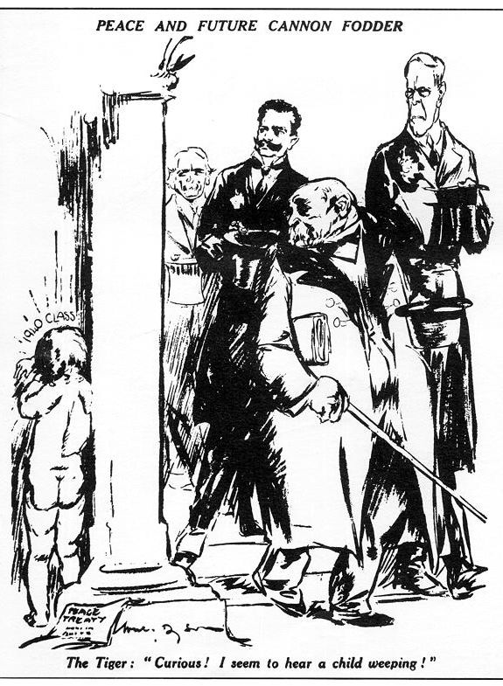

Slide 21
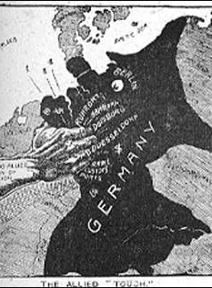

Slide 30
US Events
10 July 1919 Wilson presents the Treaty to the senate for confirmation.
3 September 1919 Wilson leaves on his tour of the US to promote the Treaty and the LoN
2 October 1919 Wilson suffers a stroke
19 November Vote in the senate for the Treaty is 55-39, which is short of the 2/3 majority required for ratification
2 July 1921 Congress passes the Knox Porter resolution formally ended the war with Germany.
25 August US-German Peace Treaty

Slide 40
Other Treaties
St-Germain (10 September 1919)
Neuilly (27 November 1919)
Trianon (4 June 1920)

Slide 45
Timeline of Sevres
May 1919 Greco-Turkish War begins
February 1920 Conference of London
April 1920 Kemal Ataturk establishes alternative government in Ankara
10 August 1920 Treaty Signed
March 1921 Ataturk signs Treaty of Moscow
October 1922 Ataturk is victorious in the Greco-Turkish War
1 November 1922 Mehmed VI resigns
23 August 1923 Treaty of Lausanne signed

Slide 47
