Slide 1
Quemoy and Matsu Crises and the Sino-Soviet Split
1954-1969

Slide 2
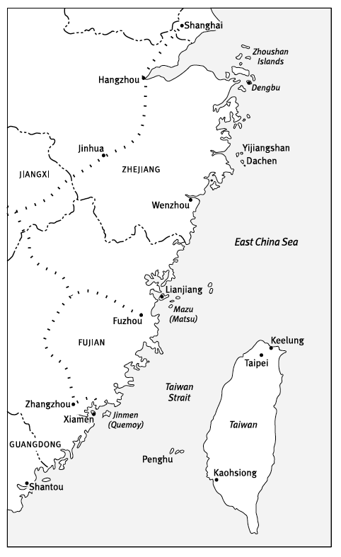
The First Quemoy and Matsu Crisis
The PLA had tried to seize both Quemoy and Matsu in early 1950, but had been defeated.
In 1954, Mao decided to seize the Taiwanese controlled islands off Zhejiang province, which was being used by the GMD to harass coastal areas. Firstly, though he wished to shell Quemoy as a distraction, and to bolster support at home before the first stage of socialist reforms. It also counterbalanced the concessions he had made at the Geneva Conference about the future of Vietnam.
Eisenhower and Dulles opted to define the defense of Quemoy and Matsu as central to American security. Letting the Chinese take Quemoy and Matsu, Eisenhower argued, would mean that the United States would have to force Chiang to remove his forces from the islands—a humiliation that would surely undermine his regime and lead to the fall of Taiwan. With Taiwan in the hands of the communists, South Korea and then Japan would in all likelihood soon succumb. Just like that, America’s allies in East Asia would be gone.

Slide 3
Results
Dulles spoke publicly of new American nuclear weaponry that could “utterly destroy military targets without endangering unrelated civilian centers,” a clear reference to the Chinese military bases being built across from the islands. A week later, Eisenhower bolstered Dulles’s tacit threat: in a combat situation, the president said, the United States would use tactical nuclear weapons “just exactly as you would use a bullet or anything else.” The intimidation worked Beijing put a halt to its aggressive activity against Quemoy and Matsu, and the nationalist garrisons remained on the islands.
Still, the first crisis was largely successful for Mao. The US and Taiwan had signed a defence treaty in response but the US did not gurantee the security of the offshore islands.
Consequently, the PLA seized the Zhejiang islands unapposed.
Satisfied, Beijing indicated that it would negotiate with the US to resolve tension in the straits. For the next three years informal discussions between the PRC and GMD took place, for Taiwan to return to China in return for limited soveriegnty.
Who won in the First Quemoy and Matsu Crisis?

Slide 4
Theory
When ideological differences exist between two countries, political leaders in one country are likely to regard the ideological and political orientation of the other country as a challenge or even a threat to the legitimacy of their own political power and their domestic ideological and socio-political programs.
For the purpose of defending and in many cases strengthening the domestic legitimacy, the political elite will almost inevitably attempt to justify their political line and policies in the domestic context.
Factions in either country will be strongly tempted to use ideological differences with the other country for their own domestic political purposes. In return, the domestic ideological and political maneuvers in one country are likely to be regarded by political forces in the other country as an even greater challenge and threat to their own domestic political order and ideological legitimacy.
Even dictatorships or authoritarian regimes have to be concerned, in one way or another, about the legitimacy of their political position, power, and policy in relation to the political and ideological circumstances in other states.
The dynamics of the ideological dilemma are likely to spill over into the national security arena, and security disputes between the two states that may have been trivial or manageable under normal conditions are very likely to evolve into real and daunting challenges to bilateral relations.
How can domestic policies potentially cause a rift between the USSR and China?

Slide 5
Maoism
Since the beginning of the PRC, the official state ideology was Mao Zedong Thought – the supreme leaders interpretation of Marxist-Leninism.
A key component of Maoism was continuous revolution.
Realist scholars adjudge Maoism as a “disguise” or “cloak” to justify decisions that are made on grounds of China’s national interests.
It was in Mao’s interests to exacerbate the Sino-Soviet split to discredit his rightist opponents.
Mao could never accept that the USSR was a global power, while China was a regional one.
Why was Mao so diplomatically unpredictable?

Slide 6
Khrushchev
After Stalin’s death, Soviet ideology moved to the right.
With de-Stalinization, the Soviet empire of ideological unity had vanished forever.
Mao regarded Khrushchev as immature, without his or Stalin’s revolutionary credentials.
Khrushchev’s impulsiveness, his lack of consideration, and his propensity to make unfounded claims or embark on adventurous but potentially damaging policies all contributed to the split.
Of course, no great power would have ceded leadership of its domain to an ally that was militarily less powerful, economically weaker, and run by a radical megalomaniac.
Why was Khrushchev unlikely to get on with Mao?

Slide 7
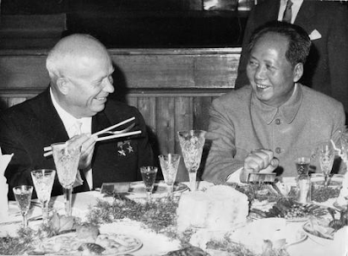
Early Attempts at Improving Relations
Khrushev initally aimed to repair the tensions that existed between Stalin and Mao.
He transferred Soviet shares in four joint companies in Xinjiang to the Chinese.
Moscow also decided to hand over Port Arthur and Dalian to Chinese control, and gave the Sino-Soviet railway in Manchuria back to the Chinese.
Khrushchev also agreed to readjust the exchange rate between the two currencies, which the Chinese had regarded as harmful to their economic interests.
The most impressive part of Khrushchev’s aid package was probably the Soviet assistance for China’s economic development – particularly China’s industrialization program, including nuclear energy technology, which began in 1955.
Soviet advisors increased from 1093 to over 5,000.

Slide 8
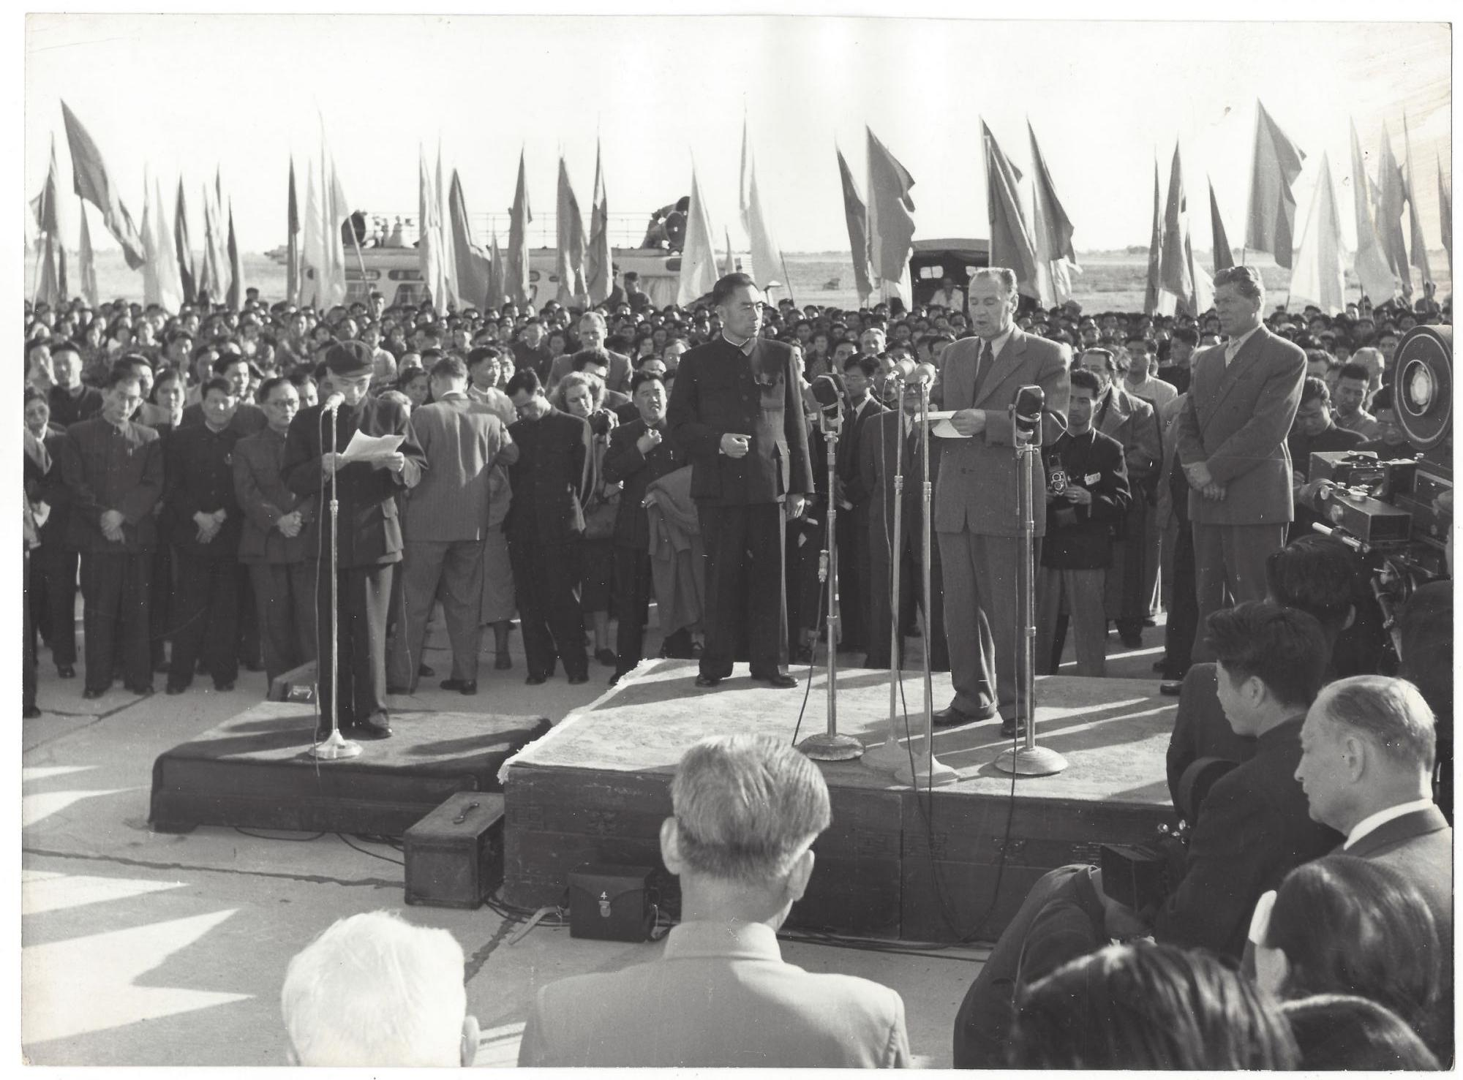
Tensions Develop
The traditional breakdown of the Sino-Soviet realtionship was traced to Khrushev’s1956 denouncement of Stalin.
However, the change of policy had been signposted. Mao disagreed, eventually finding Stalin to have been 70% correct.
Still, the Soviet change allowed Mao to air his disagreements with Stalin during the Civil War and about his treatment on his first visit to Moscow.
He praised the USSR for making necessary corrections and lauded them as the key bastion against imperealism. He also welcomed the opportunity to pursue greater independence.
Still, when civil unrest broke out in Poland following Khrushchev’s speech, Mao (in his pyjamas) warned the Soviet ambassador that if the USSR intervened militarily then he would defend Poland. Mao blamed the Hungarian crisis on Khrushchev’s ‘zigzagging.’ Zhou Enlai’s visit to Budapest shortly afterwards where he compared recent events to those in 1917, enraged the Soviets.
How important was Khrushchev’s secret speech in the breakdown of relations?

Slide 9
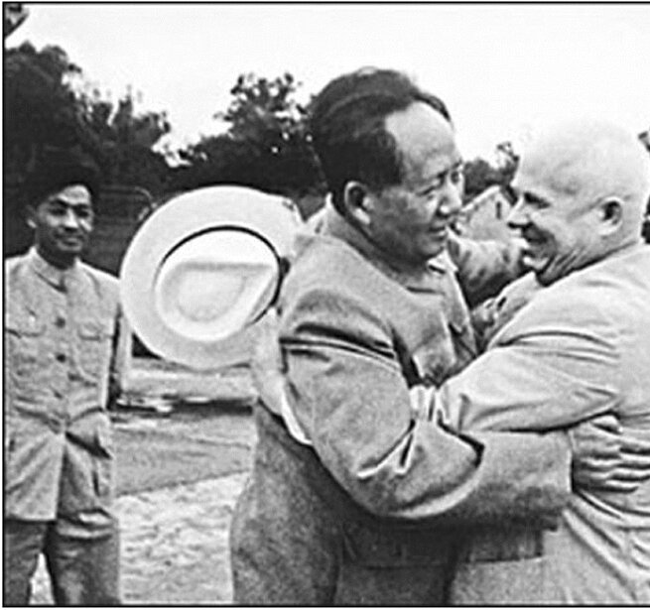
Personal Insults
To Mao, Khrushchev had little revolutionary vigour and no long-term plan, and was far from being a visionary.
The Chinese put Khrushchev in accommodation without air-conditioning when he visited in 1958. When he tried to sleep outside, he was badly bitten by mosquitos. The next day he further humiliated Khrushchev (who couldn’t swim) by scheduling their meeting in his swimming pool.
They took turn at exchanging insults. Mao complained that Khrushchev’s stories were boring during a state dinner.
The CCP bitterly opposed Khrushchev’s 1959 visit to the US. He was not greeted at the airport when he arrived in Beijing from Washington for the 10th anniversary celebrations. Mao felt Khrushchev had undermined his anti-capitalist/imperialist showcase by publicly praising Eisenhower. Khrushchev never visited China again.
Khrushchev criticised Mao for not consulting with India before the brutal suppression of the 1959 Tibetan Rebellion. The Soviet Premier believed the resulting border skirmish needlessly pushed the non-aligned power towards the USA.
How far did personal slights contribute to the split?

Slide 10
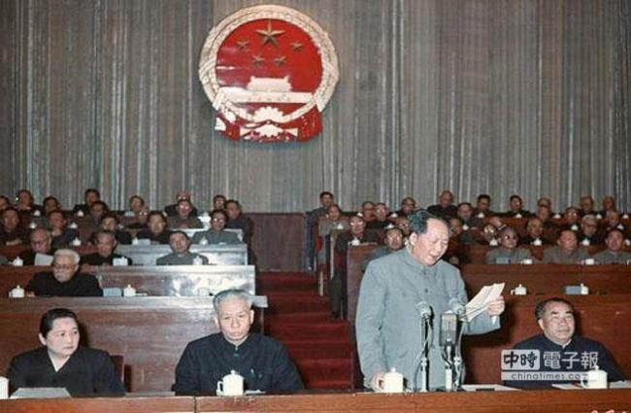
Domestic Issues
The failure of the 100 Flowers campaign raised doubts in Mao about the wisdom of dismantling the Cult of Personality.
Mao disagreed with ‘Peaceful Coexistence.’ Likewise, Mao’s seeming indifference to nuclear confrontation raised concerns in Moscow (partly as the USSR had nowhere near the nuclear parity they claimed).
It was the significant internal opposition, led by Zhou Enlai, to the ambitious targets of the Great Leap Forward, which saw Mao criticise them as slavish devotees of the Soviet model. When Peng Dehuai (he disliked the employment of the military to achieve production targets) attacked Mao at the 1959 Lushan Conference, he was denounced as a Soviet agent. Khrushchev responded by attacking the results of the Great Leap Forward in order to restore faith in the Soviet model in Eastern Europe. His advice to rehabilitate Peng further poisoned relations.
Mao, favored international tensions because they helped create a siege mentality, which helped to mobilize the domestic population to achieve their utopian economic targets. Domestically, the failure of the GLF was blamed on rightist elements.
How far was Mao on the backfoot in the late 1950s and how could waning domestic power lead to a deterioration in relations with the USSR?

Slide 11
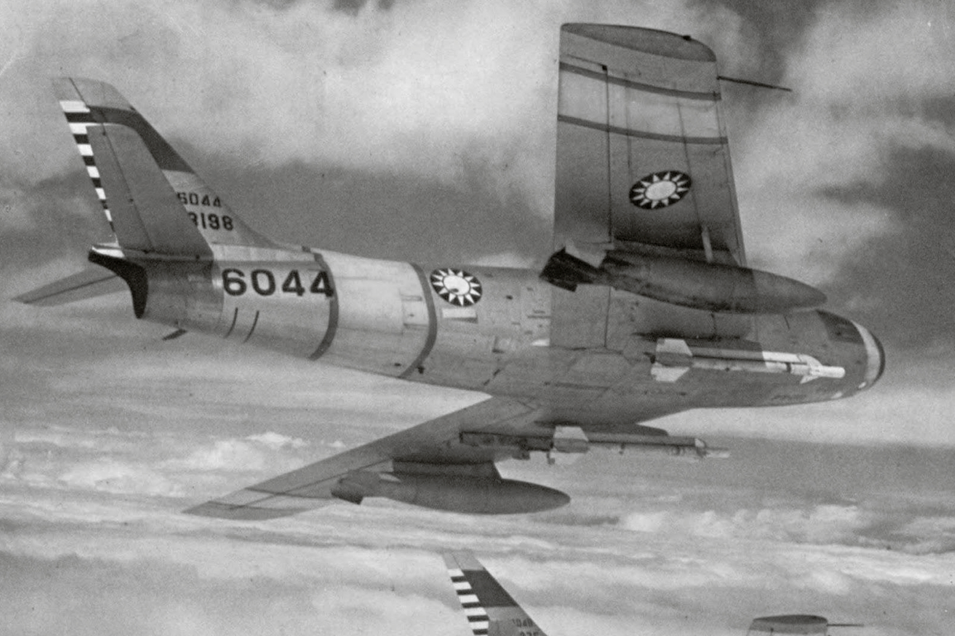
Mao Makes a Move
In Summer 1958, Mao took extreme umbrage at Soviet chauvinism after they proposed a long-wave radio station and a joint Sino-Soviet Pacific nuclear submarine force.
Khrushchev flew to Beijing to smooth over the disagreements. However, there was no welcome ceremony and Mao was in no mood to negotiate. The Soviet premier could not understand why he became so angry (it was really about Soviet critiques of the People’s Communes and the GLF). On retruning to the USSR Khrushchev “warned that “it is unwise to behave like a bellicose cock and to long for war.”
Shortly after Khrushchev’s visit China gained hold of a sidewinder missile that failed to detonate from a Taiwanese aircraft. China refused to hand it over, which caused Khrushchev to block Chinese access to Soviet nuclear technology.
How far were the disputes in 1958 premeditated?

Slide 12
Second Quemoy and Matsu Crisis
Between 5:30 p.m and 7:00pm on 23 August 1958, the People’s Liberation Army units in Fujian province poured more than 30,000 shells on Quemoy. About 600 GMD officers and soldiers were reportedly killed. The shelling continued for the next six weeks and a amphibious invasion looked likely.
Mao likely undertook the bombardment due to China’s increased military infrastructure in the area, a desire to test the US commitment to Taiwan, or other NATO powers commitment to the alliance. It also aimed to increase support for the GLF. Publicly Mao defended his action as a legitimate defensive measure following the US and British military interventions in Lebanon and Jordan following the socialist Iraqi coup.
The US decided early on, that it would not allow the capture of Quemoy and Matsu, but any defense of the islands would not involve attacks on the Chinese mainland.The Eisenhower administration reinforced the strength of the Seventh Fleet in East Asia and ordered U.S. naval vessels to protect Jinmen’s supply lines.
Why did Mao restart the dispute over Quemoy and Matsu?

Slide 13
Russian Reaction
Moscow supported Beijing during the Second Quemoy and Matsu crisis. But, it only threatened nuclear war after a diplomatic solution looked likely. Despite China breaking agreements to keep each other informed on foreign policy initiatives
However, they were angered that it implicated themselves coming so soon after Khrushchev’s visit, undermining ‘peaceful coexistense.’ They found Chinese requests for air support nauseating after the disagreements just a few weeks before.
The ease with which Beijing had nearly forced Moscow to commit itself to nuclear war troubled the Kremlin. The crisis and Soviet- American nuclear disarmament talks were both factors in the Soviet decision to rescind its October 1957 promise to deliver China a model A-bomb.
Why did the USSR support China?

Slide 14
Resolution
The sinking of GMD supply ships led to a major air battle above Quemoy in which both sides claimed victory.
An unsanctioned announcement by the Fujian military command of an imminent invasion of Quemoy saw the US pledge to defend every part of Taiwan. The US also sent the Seventh fleet to escort Taiwanese vessels through waters claimed by China, while publicily declaring an openess to diplomatic talks.
Mao may have been confident, that the US feared China more than he did them, but his strategy made little sense. The shelling and the intervention of the US fleet made a takeover of Taiwan implausible. Telling millions of Chinese that Jinmen and Mazu had become ‘‘nooses’’ for the Americans and holding anti-American demonstrations and rallies throughout China, was not a smart play when diplomatic talks were about to begin.
However, the US lacked support from its allies and was keen to cut a deal. It floated the return of the islands in return for iron clad guarantees of both China and Taiwan’s sovereignty. But Mao, didn’t really want the islands, he preferred them as a perpetual bargaining chip. In the end, the islands were demilitarized and the shelling became a ceremonial event at noon every second day.
The Quemoy and Matsu crisis partially explains the Sino-Soviet split. Eisenhower could and did ignore Mao when he acted out to bolster his diplomatic credibility. Khrushchev didn’t have that luxury.
Who won the second crisis?

Slide 15
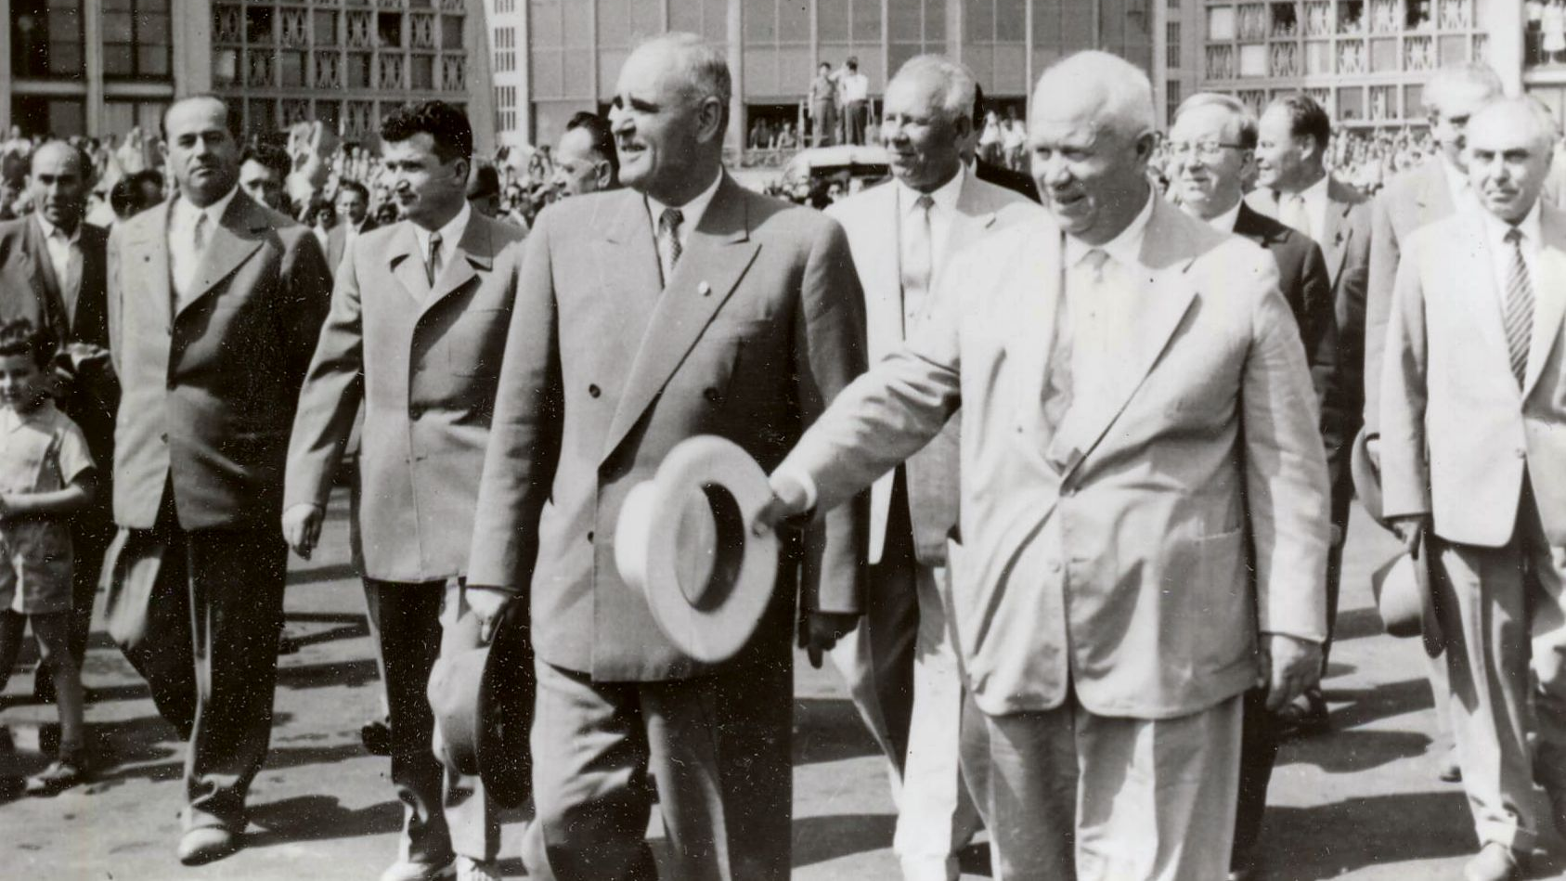
1960
By the beginning of 1960, Mao decided the material benefits of the Sino-Soviet pact were not worth the acceptance of themselves as the scondary Communist power. Sickened by the extremism—real and perceived—of Chinese foreign policy and by Mao’s Stalin-like personality cult, Moscow decided to reassert its leadership in the socialist camp.
China sent the ultra-leftist, Kang Sheng, to the Warsaw pact meeting in February . Kang crticised rapproachment with the USA and Khrushchev responded at the farewell dinner by drunkenly ridiculing Mao. In repsonse to ‘celebrate’ Lenin’s 90th Birthday, Mao propogated a series of articles that distinguished their interpretation of Leninism from Soviet doctrine.
The growing isolation between the two states became public at the 1960 Bucharest Conference. Khrushchev accused Mao of being an ultra-leftist, an extreme dogmatist, and a complete left revisionist; he condemned China for practicing big-power chauvinism in Sino-Indian relations. Khrushchev attacked Mao by name, referring to him as another Stalin who, oblivious to interests other than his own, kept spinning theories detached from the realities of the modern world. He again accused Mao of wrongly purging Peng Dehuai, for daring to criticize the policy of communes. Aid was cut to Albania for supporting China in the disagreement. Mao was compelled to send grain to Albania, despite suffering a minimum of 13.5 million famine deaths in 1960.
The Chinese delegation strongly rebuffed Khrushchev, leading to Soviet uproar. As the difficult economic situation caused by the new round of Great Leap Forward programs in the first half of 1960 might lead China to require Soviet assistance, most top CCP leaders were not prepared to see a complete split with the Soviets.
After the conference all Soviet advisors were withdrawn and the publication of the journal, Friendship, ceased. The withdrawal of the advisors was not a big a deal as it appeared, as their advice had been ignored during the GLF.
Why did relations deteriorate further in 1960?

Slide 16
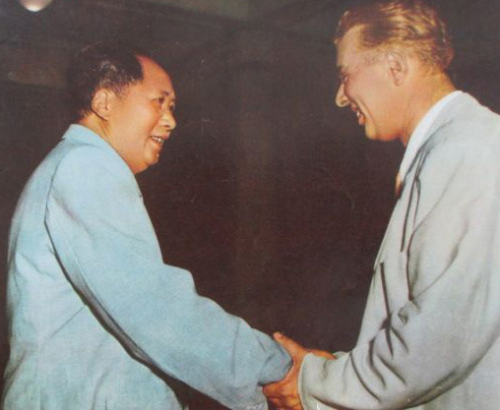
1960 Conclusions
By the end of the year both sides realised they needed to pull back to avoid a full split. Mao privately questioned why Khrushchev could get along with US, European, Non-Alligned and Yugoslavian leaders, but not China. Really, he should have questioned why China was so isolated. Still, Khrushchev’s power was waning. His Kremlin colleagues now viewed him as unnecessarily provocative, citing the handling of the U2 incident, isolation of China and Albania (particularly the abusive speech levelled at Khrushchev by Enver Hoxha), and the shoe banging in the UN.
Mao also started to believe that the Chinese historical experience should serve as the model for the entire socialist world. In his mind, the CCP was a beacon of light in a world that had forsaken the truth of Marxism- Leninism. He apparently still had not understood that his brand of Marxism-Leninism was responsible for deadly mass famines in China and that few people in the world thought it attractive enough to be aspired to.

Slide 17
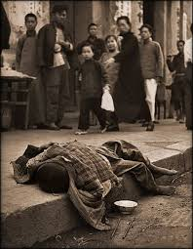
Temporary Improvements
In 1961-62 relations between the two countries normalised. The economic failures of the GLF, saw Mao moderate his policies. A welcome development for most in the CCP leadership. Mao was marginalised for much of 1961-1962. He admitted mistakes at the 7,000 cadre conference, but a lack of specifics saw the CCP adopt a Soviet style five year plan. Mao sulked in Wuhan for the remainder of the year, his mood not helped by Liu Shaoqi’s How to Be a Good Communist outselling his collected works.
MiG fighter technology was shared.
Khrushchev offered a five year interest-free moratorium on the Chinese debt.
Food aid was sent, despite the USSR having to import food for the first time since the 1930s due to the failure of the Virgin Lands program.
China declined an Albanian demand for military assistance.
Papers were produced stressing courteous diplomatic behaviour towards the USSR. Pronouncements were made supporting ‘peaceful coexistence.’
However, underlying tensions were not resolved. China decided to arrange grandiose celebrations of the 45th anniversary of the October Revolution, in order to revive the October Revolution’s tradition of struggle and publicize Marxism and Leninism. In publicizing Soviet achievements, the media was to devote space and broadcast time to discussing Soviet achievements in general terms, but downplay their achievements in recent years. “there was to be no thanking the Soviets for their assistance to China, no acknowledgement of Soviet support for China’s sovereign and territorial integrity, and no mention of learning from the Soviet Union.
Mao accused Khrushchev of ‘great power chauvinism’ for withdrawing its submarines from Albania. They took Khrushchev’s removal of Stalin’s body from Red Square and his criticisms of Hoxha as an attack on them.
China became angry that 67,000 people of Russian and Central Asian ancestry were allowed to flee from Xinjiang to Soviet Kazakhstan following riots and food shortages. In response the USSR diplomatic and trade presence was confined to the embassy in Beijing.
Did Sino-Soviet relations improve?

Slide 18
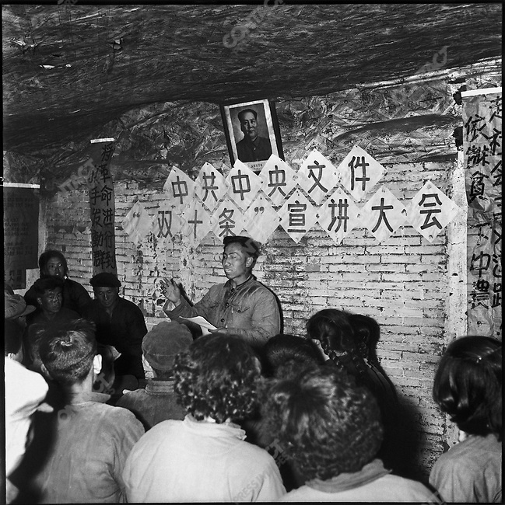
1963
In 1963 Mao launched his Socialist Education Movement, after he found provincial leaders were reluctant to promote radicalism in rural areas fo fear of disturbing the fragile economy. One of the main weapons in Mao’s ideological arsenal was the call to fight revisionism everywhere with the slogan fanxiu fangxiu (oppose revisionism abroad, prevent revisionism at home).
Mao believed that China’s rural areas had been controlled and ruled by corrupt local cadres. Therefore, a four-point clean-up campaign was initiated within the Socialist Education Movement, which focused on sending 1.5 million loyal cadres to clean up the management of accounts, granaries, property and work points. The targets for the urban Five-anti Campaign included graft and embezzlement, speculative activities, extravagance, dispersionism and bureaucratism.
China took a more active role in world affairs. Mao was buoyed by his rout of Indian forces in the second indo--Chinese border skirmish. After staying quiet in 1962, Mao criticised Khruschev for caving to US imperialism during the Cuban Missile Crisis. The Chinese leadership staged mass rallies supporting Cuba’s struggle and accusing the USSR of “adventurism” for sending the missiles and of “capitulationism” for withdrawing them. In response the USSR resumed arms sales to India.
China objected to Khrushchev welcoming Tito back to Moscow, seeing the Yugoslavian leader as the arch revisionist.
Seven editorials (supervised by Mao) were published in Chinese newspapers. In May 1963 the Chinese Embassy in Moscow had distributed over 5,000 copies of counter-revisionism brochures in Russian, Vietnamese, Spanish, French and English.
Khrushchev invited Mao to Moscow for discussions, but he torpedoed the talks by publishing a 25 point denouncement of the USSR in the People’s Daily which essentially claimed that they had moved away from Marxist-Leninist orthodoxy. The only thing agreed at the talks (Deng Xiaoping not Mao attended) was to hold further talks in the future.
In March 1964, a Romanian delegation visited Beijing to request the end of the anti-Soviet polemics. Mao dismissed them as a Soviet plant.
In July 1964, Mao equated the USSR with expansionist Tsarist Russia who he claimed had occupied millions of km2 of Chinese territory. In response “the Soviets began to substantially increase their military power along the borders and also began to enhance security ties with Mongolia, which further aggravated China’s national security position. The dispute was no longer about ideology, with Mao claiming Tsarist Russia had absorbed 1.5 million km2 of Qing China.The Soviet politburo now had to fervently research the origins of its Eastern borders.
Why now is the split almost unreconciliable?

Slide 19
The Nuclear Factor
Mao had always been dismissive about any attempt to limit nuclear weapons. Even after the Cuban Missile Crisis, Mao stated nuclear weapons were “paper tigers the U.S. reactionaries use to scare the people,”
The USA feared China becoming a nuclear power, but knew that it would become one soon.
As Sino-Soviet relations continued to worsen until mid-1963, Soviet - American relations on nuclear arms testing improved so much that, in the spring, Khrushchev faced a difficult choice: ideological surrender or nuclear arms regulation.
With his key advisor, the anti-US pro Chinese, Kosilov suffering a stroke in early 1964. The under pressure Khrushchev took the bold move of floating an arms limitation treaty if the number of inspectors could be kept secret and nuclear weapons were kept out of West Germany.
The USA, USSR, and Britain signed a limited nuclear test ban treaty in August 1963, that was endorsed by a further 107 countries. China along with North Vietnam and Korea, Albania, and Cuba refused. France also refused to sign.
Why did Khrushchev choose rapproachment with the West over improving relations with Mao?

Slide 20
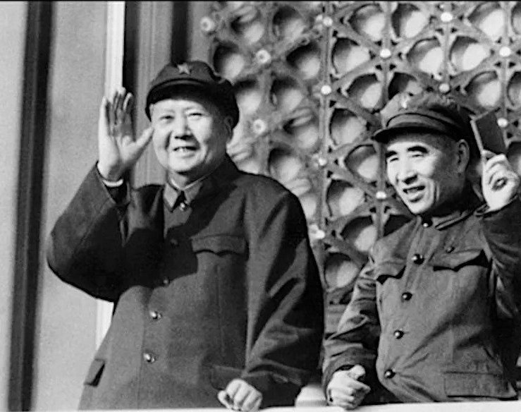
Precursor to the Cultural Revolution
Mao believed Khrushchev had been forced to step down in October 1964 due to opposition to his revisionist scientific Marxism. He was soon disappointed when the Brezhnev regime informed him they would be continuing Khrushchev’s policies. Still, Brezhnev favoured a normalisation of relations and greater coordination of support for North Vietnam, he like his predecessor could not tolerate the Chinese polemics.
This would be short-lived when, Rodion Malinovskii, the Soviet Defence Minister, told Zhou Enlai to get rid of Mao in order to fully normalise relations. This suggestion was particularly unwelcome as it was precisely what Mao feared the most. This is why Zhou refused to accept the Soviet apology and explanation that Malinovskii was drunk, stating “truth lies in wine.”
The polemics began again, despite Communist parties begging China to stop. China rejected a Soviet request to attend a March 1965 conference about assistance to Vietnam.
On the eve of the Cultural Revolution, the anti-American pro-Soviet defense minister, Luo Ruiqing, was replaced by Lin Biao. Lin downplayed the US threat and instead presented the Soviet Union as China’s most menacing enemy. He, therefore, emphasized the creation of a massive militia which could ultimately defeat any foreign invader through a prolonged “people’s war.”
While the CCP leadership continued to maintain contact with Soviet officials, Mao decided that it was time to make a complete break, refusing to send delegates to the 23rd Soviet Party Congress in April 1966.
Why did the Cultural Revolution require a complete break with the Soviet Union?

Slide 21
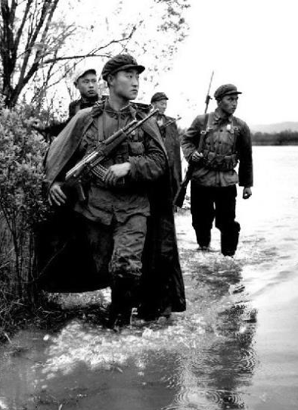
Further Deterioation During the Cultural Revolution.
The Cultural Revolution alienated China from other Communist nations. Even Hoxha—Mao’s only friend—distanced himself from the Chairman, calling the actions of the Red Guards “dangerous” and the Cultural Revolution a “rectification of the entire line of the party. . . undertaken outside the Leninist norms of the party and the laws of the dictatorship of the proletariat.”
Throughout the Cultural Revolution, the Soviet Union was systematically demonized in China. Sino-Soviet hostilities reached an unprecedented level, as exemplified by Mao’s designation of Moscow as China’s primary enemy in October 1968, replacing the United States as the “most evil” power. China stated that Soviet policies served to “safeguard imperialist and colonial domination in the capitalist world and restore capitalism in the socialist world.”
There was a lack of joint action in Vietnam. North Vietnam was desperate for Soviet technology and advisors to counteract US air power, and Brezhnev, unlike Khrushchev, was willing to provide it. But China obfuscated this aid. As the biggest supplier of military aid between 1960-1964, North Vietnam could not alienate its northern neighbour,
Protests outside the Soviet embassy in August 1966, saw diplomatic protests, which were met by even larger demonstrations. Monuments of Sino-Soviet friendship were destroyed and Soviet citizens living in China at that time experienced hooliganism, searches, assaults, and other outrages perpetrated against them.
In January 1967, Chinese students and Russian police clashed outside Lenin’s tomb. They were welcomed back with another round of protests at the Soviet embassy and by 100,000 at the Workers Stadium in Beijing.
In 1967 in Dalian, a Soviet merchant officer allegedly refused a badge of Mao and threw it into the sea. When the captain refused to hand over the ‘perpetrator’ the entire crew was paraded through the streets and the ship was impounded. Only when the USSR threatened full suspension of trade relations was the ship allowed to leave. But the next day protestors entered the Soviet embassy assaulting staff and destroying property.
Actual fighting began in March 1969 on the disputed Zhenbao Island in the Ussuri river. 31 Soviet border guards were killed and an unknown number of Chinese. China claimed that 260 million participated in anti-Soviet protests following the skirmish. When Brezhnev tried to call Mao about the incident the Chinese receptionist rebutted Brezhnev, saying that Chairman Mao would not speak with him on the phone as Mao represented Marxism-Leninism and he represented revisionism. There would be a further 4,000 border incidents, resulting in five Chinese deaths and 122 injured. Ten Soviets were injured.
In 1968, all trade halted.
How are the Chinese behaving in a hypocritical way?

