Slide 1
The Building of the Berlin Wall

Slide 2
Why was the Berlin Wall Built?
Ulbricht’s policies had seen 3.1 million leave the GDR by 1961. It was incredibly repressive (1953 strikes), Stalinist style rule with little economic or political freedoms.
After 1960, the GDR pursued an independent foreign policy with the more volatile Mao. Khrushchev worried that if they didn’t intervene then the GDR would get itself potentially involved in a war with NATO.
In June, Kennedy implies that NATO will only intervene to protect W Berliners and in July , Fulbright openly asks why they don’t simply close the border.
After the ultimatum, the number leaving reached crisis levels (2000 a day), the GDR could no longer function.

Slide 3
Why was Berlin so tense in the 1960’s?
It was a symbol of the division between the West and the Soviet Bloc. It is in the centre of E Germany and is easily accessible.
In 1958, Khrushchev delivers an ultimatum for the Allies to make Berlin a free city. Berlin is the allies weak point ‘testicles’. Khrushchev increases his own standing after the ultimatum passes, but so too does Eisenhower.
In 1961, Khrushchev again puts pressure on Kennedy by delivering another ultimatum of 6 months at the Vienna Conference; he thinks that Kennedy is weak and controlled by his advisors.
On August 12 1961, the SU completely separated Berlin with a wall.

Slide 4
How did the Allies react to the Berlin Wall?
Initial reaction was surprise. Expecting nothing to October (Party Conference). Kennedy did not know until 18 hours after it was built.
Kennedy was cautious. Protest was only issued four days after, no demand to take it down.
‘Wall is better than a War’. Britain and France were not offering much support. Kennedy realises that the wall represents a propaganda victory.
VP Johnson is sent 20 August to reassure Berliners and received a huge ovation.
President Kennedy visits in June 1963, huge crowds ‘Ich Ben Ein Berliner’

Slide 5
How did it effect Berliners?
239 were killed trying to cross the border. 5000 were successful.
7200 were arrested and sent to Hohenschonhausen
32,000 lost their jobs. 24,000 only low skilled forever.
High schoolers could not finish their education. The rest were split up around the city.
Families were separated for 28 years.
Some E Berliners who did not work in the W supported it, felt they were freeloaders.

Slide 6
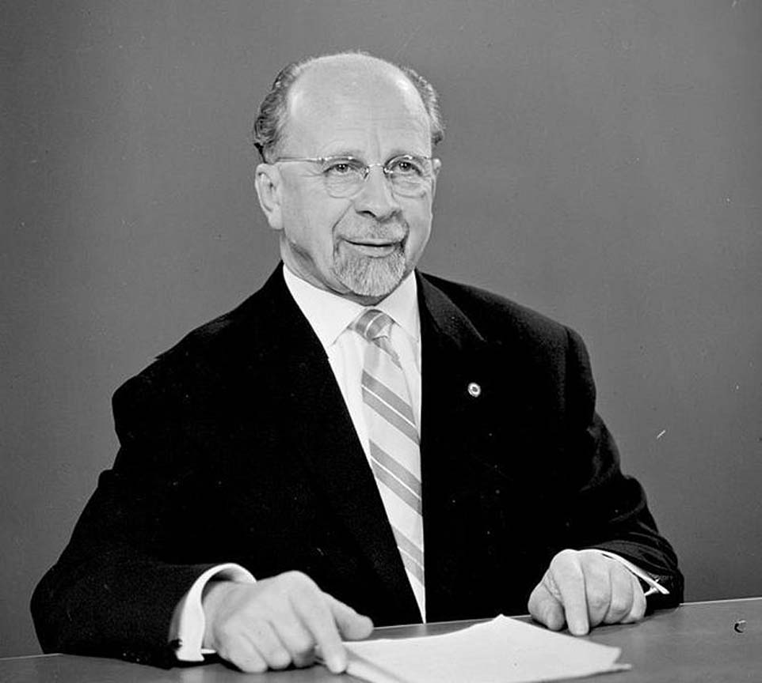
Walter Ulbricht

Slide 7
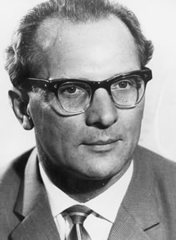
Erich Honecker

Slide 8
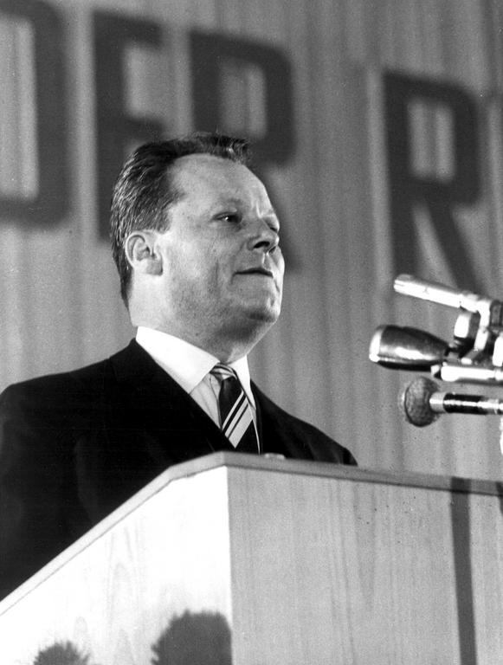
Willy Brandt

Slide 9
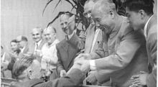

Slide 10
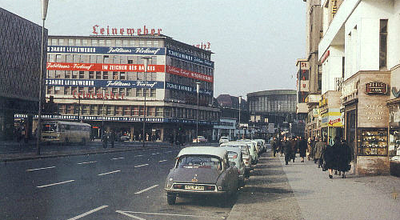
West Berlin in the 1950’s

Slide 11
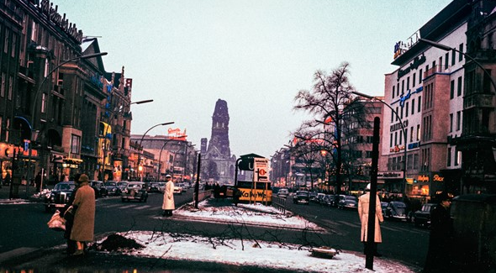
West Berlin

Slide 12
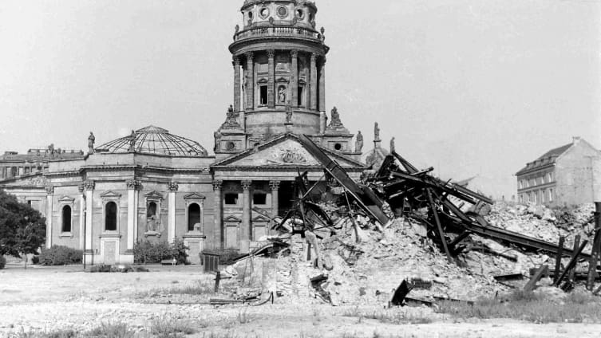
East Berlin 1959

Slide 13
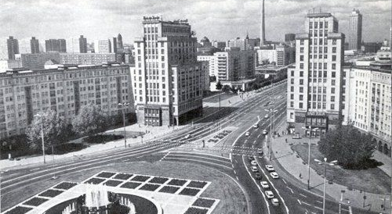
Karl Marx Boulevard

Slide 14
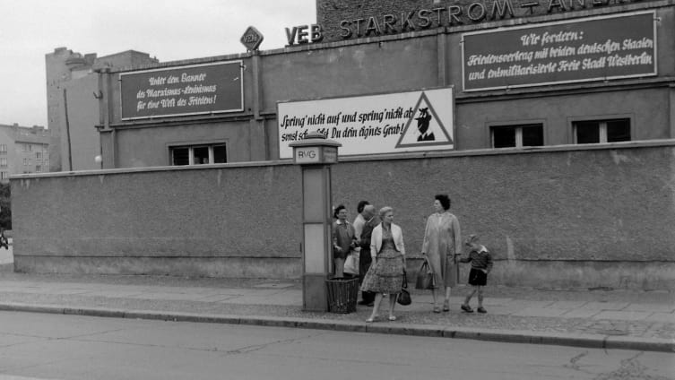
East Berlin in the 1950’s

Slide 15
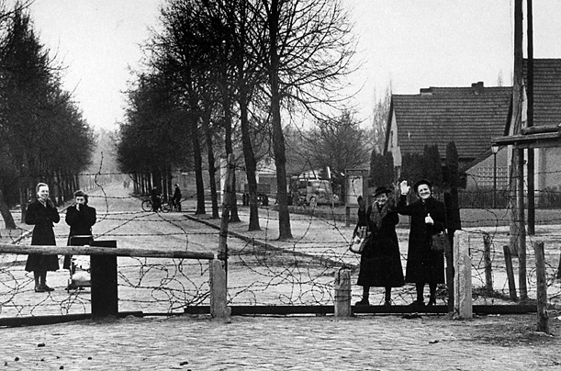
Earlier Version from 1953

Slide 16
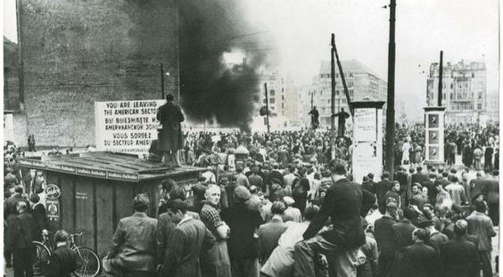
Strikes in 1953

Slide 17
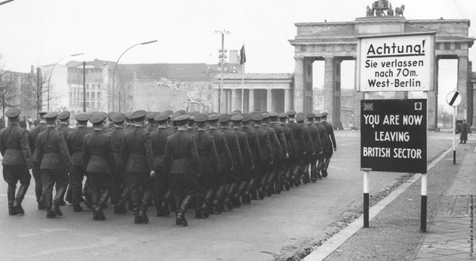
Russian Troops return 1956 (from a memorial)

Slide 18
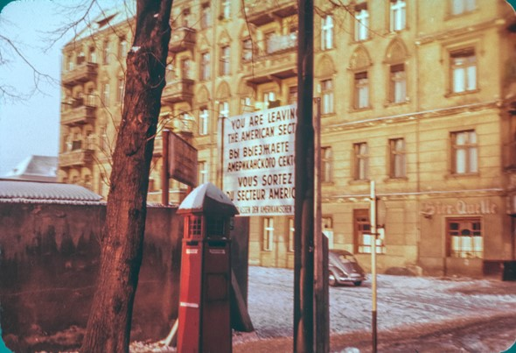

Slide 19
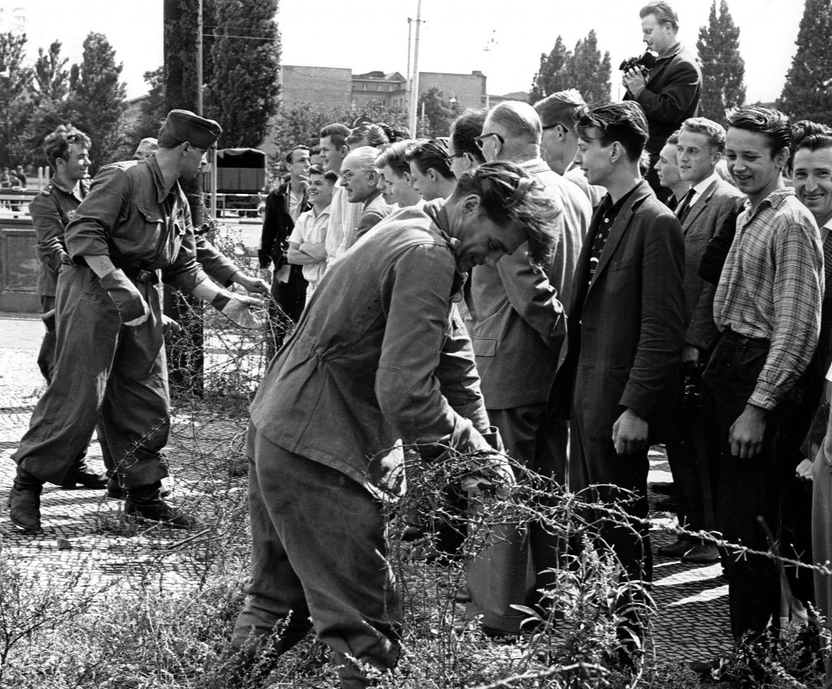
Barricades go up on 13 August

Slide 20
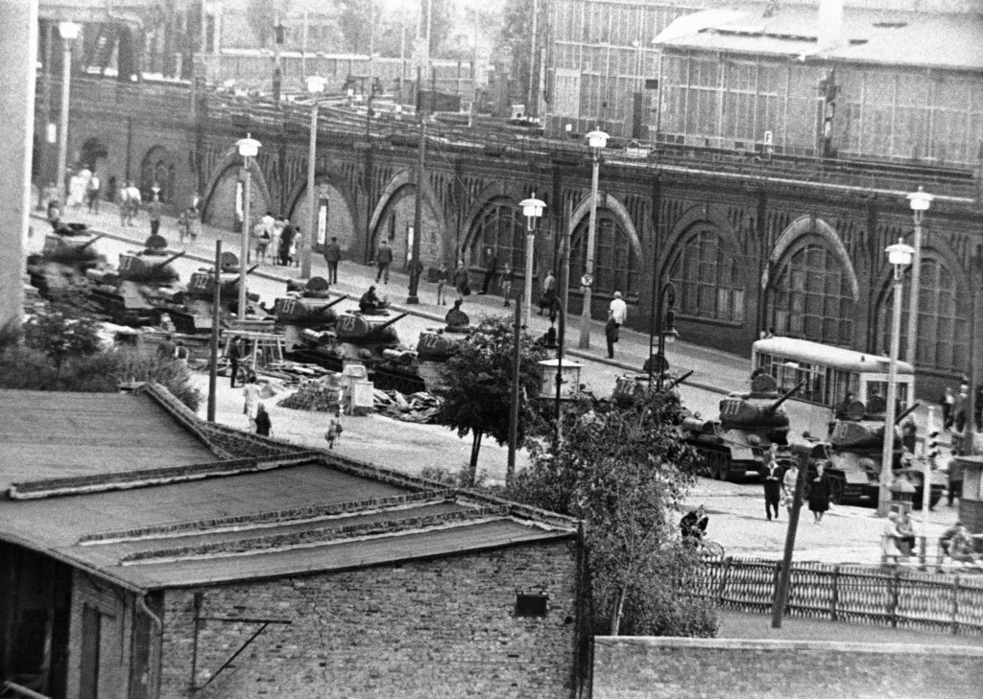
GDR Tanks wait in case of emergency

Slide 21
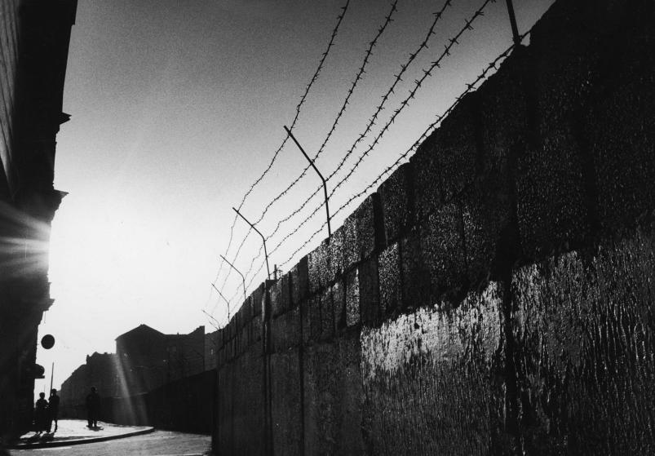
Shortly after construction in August 1961

Slide 22
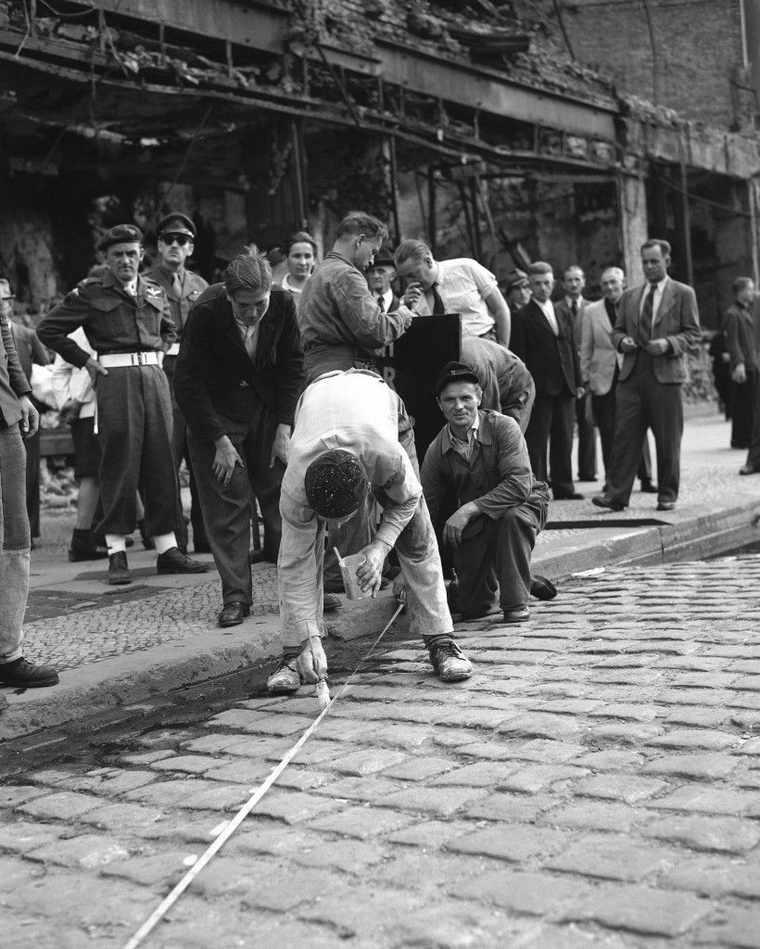
Marking out Potsdamer Platz while British Soldiers look on

Slide 23
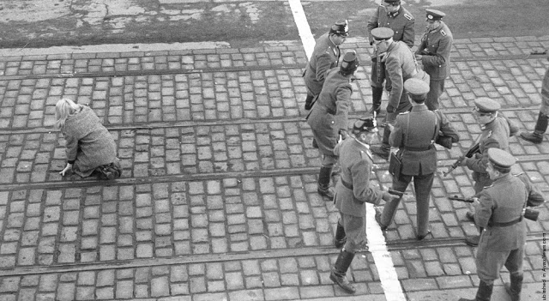
Guards face off in August

Slide 24
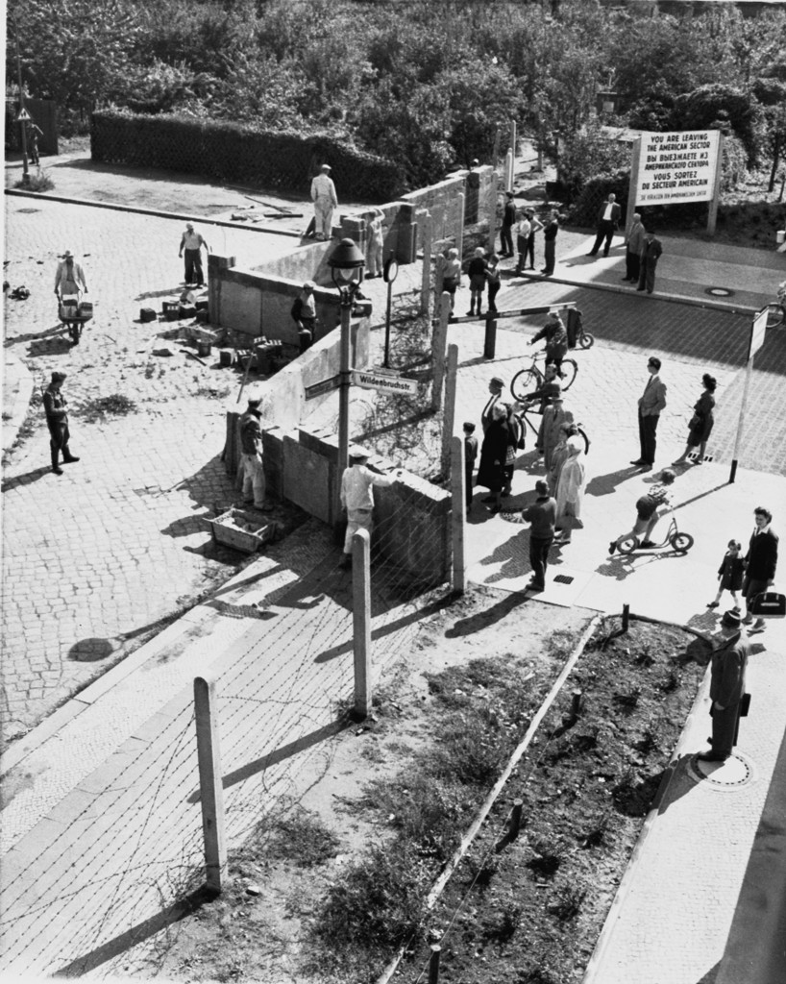
West Berliner’s watch construction

Slide 25
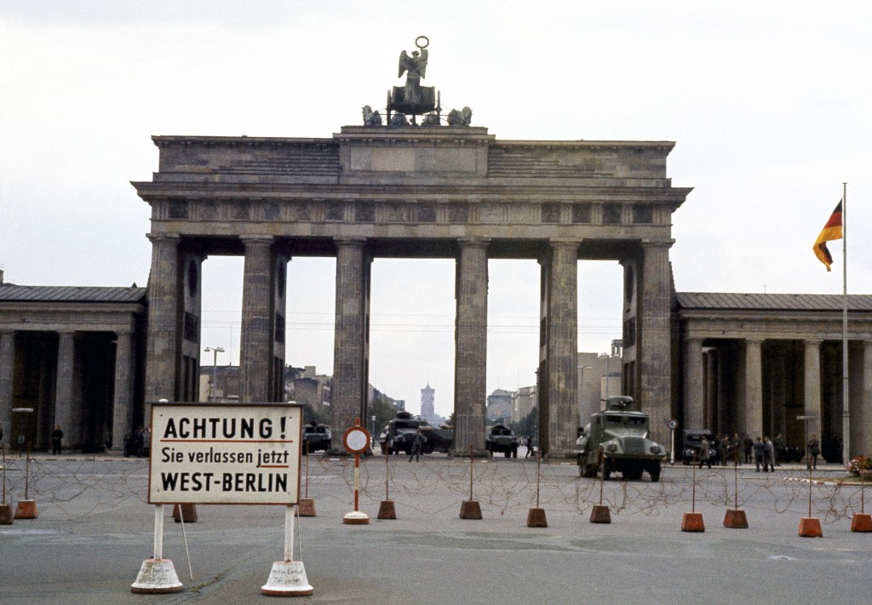
Brandenburg Gate on 13 August

Slide 26
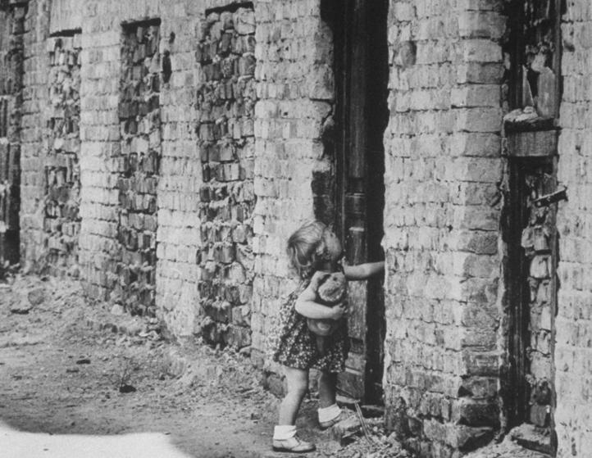
West German toddler tries the door of a house that has been sealed up to form part of the Wall

Slide 27
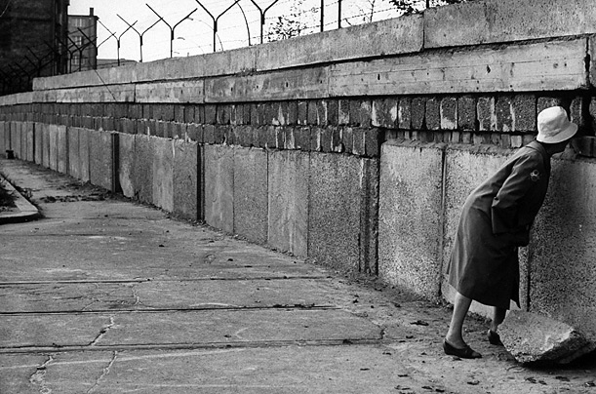
Woman looking through in 1961

Slide 28
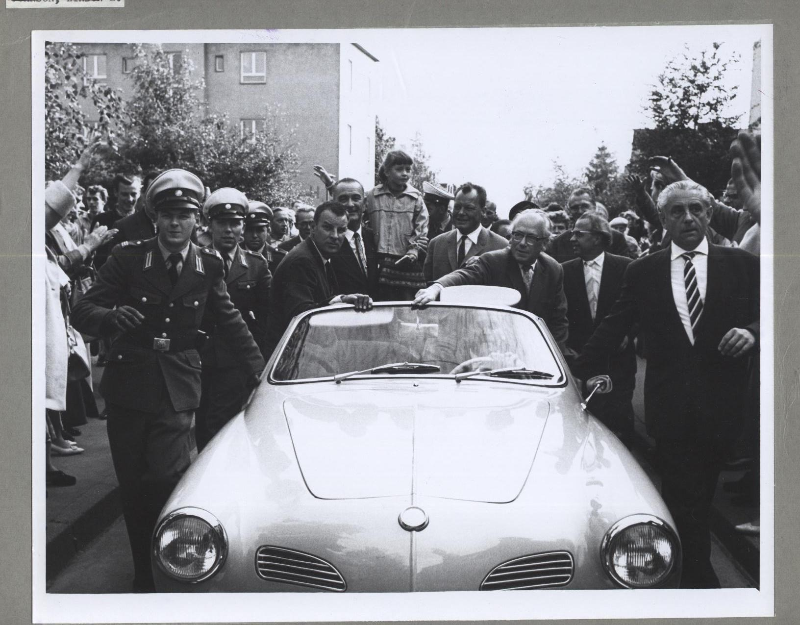
Vice President Johnson in Berlin

Slide 29
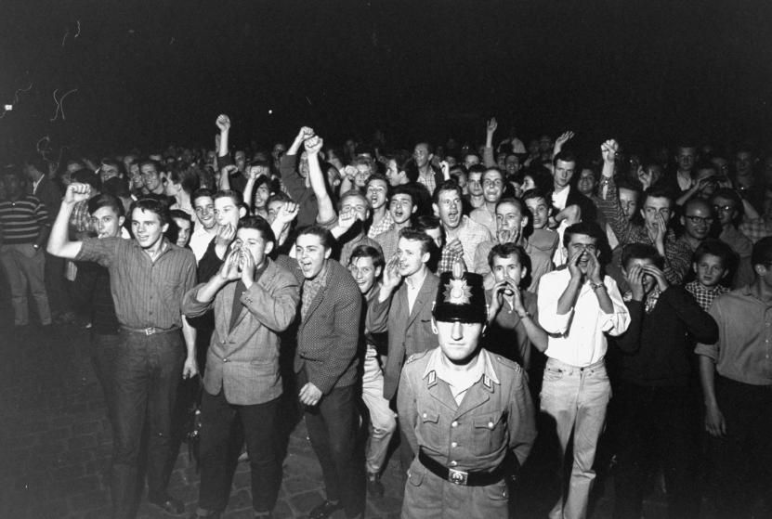
West Berliners protest at the construction

Slide 30
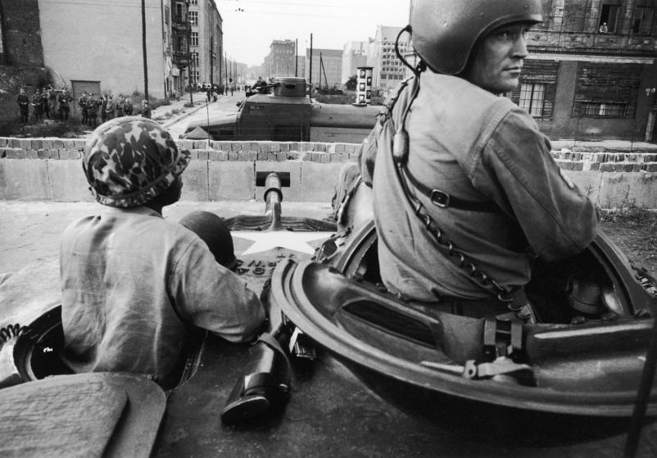
American troops face East German’s during construction

Slide 31
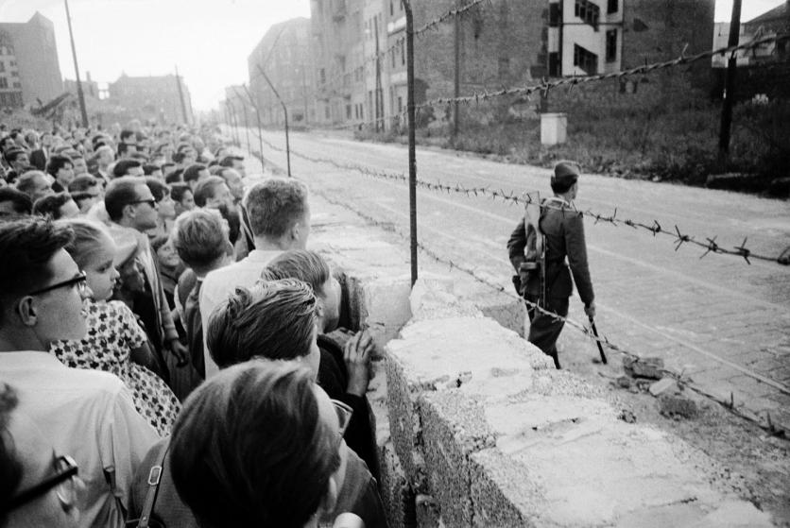
West Berliner’s watch a GDR patrolman

Slide 32
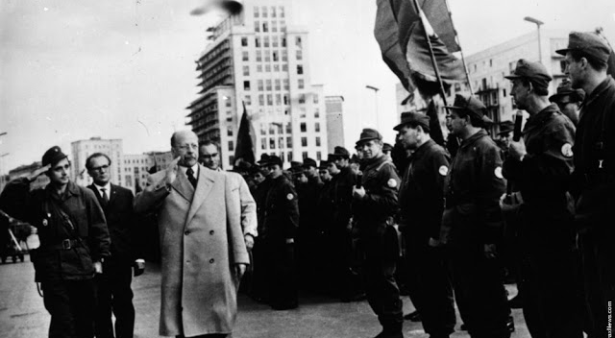
Honecker visits the contruction workers

Slide 33
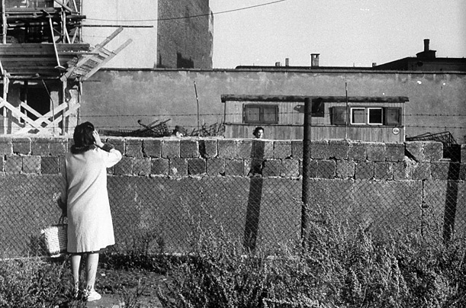
A Woman who escaped talks to her mother in 1961

Slide 34
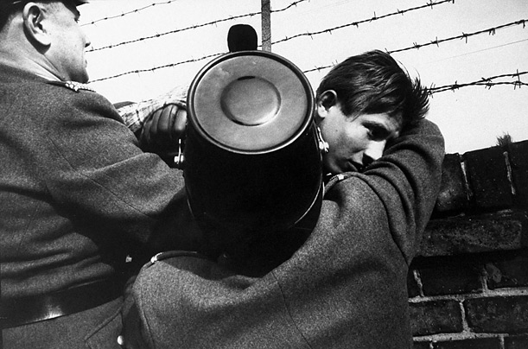
A Boy makes it over an early version of the Wall

Slide 35
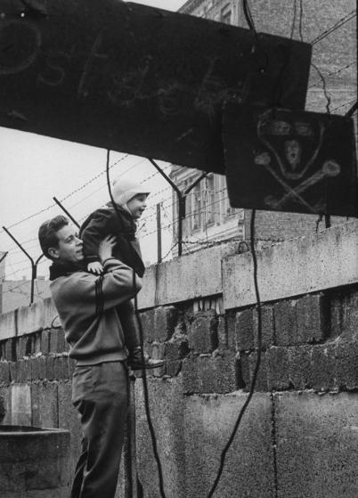
West German Man show his son the other side of the Wall

Slide 36
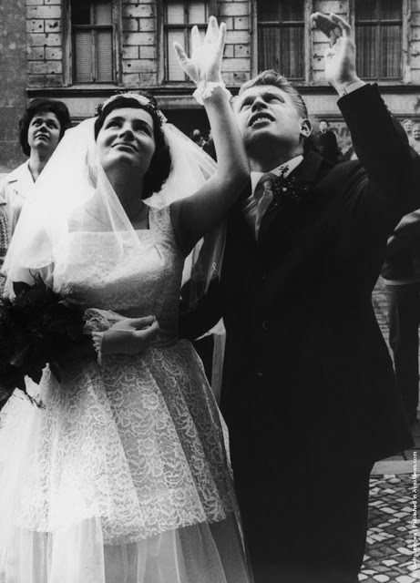
Married Couple wave to relatives

Slide 37
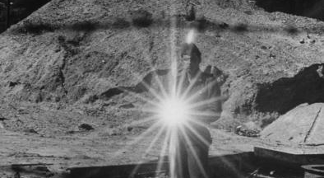
GDR Policeman uses a mirror to stop photographers

Slide 38
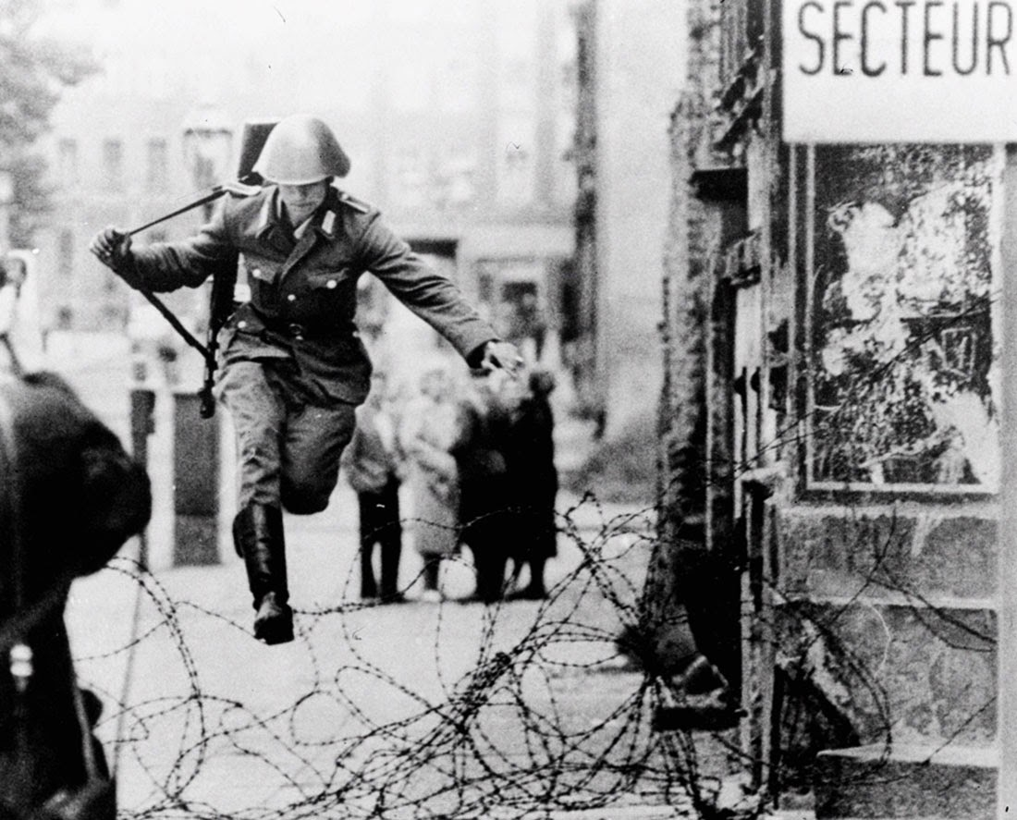
The famous ‘Leap of Faith’ photograph

Slide 39
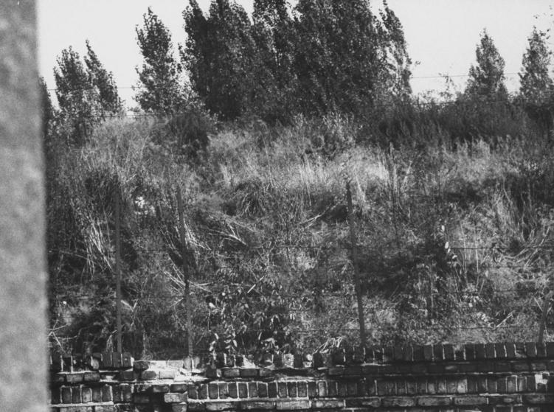
East Germans hide in tall grass to wait for a chance for an attempt to jump

Slide 40
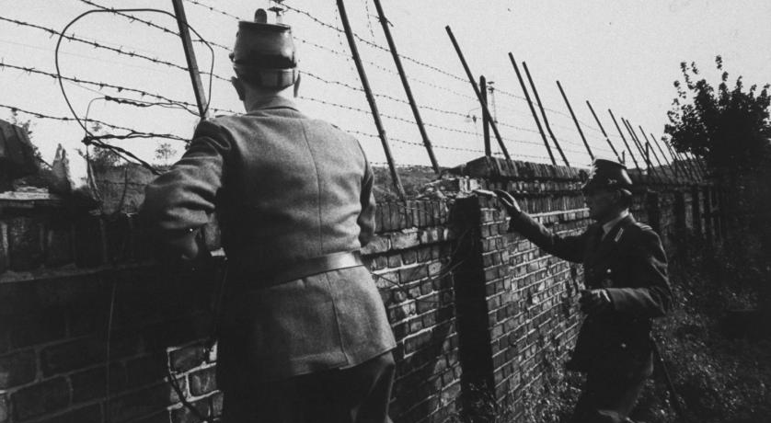
West German Police wait to assist any potential refugees

Slide 41
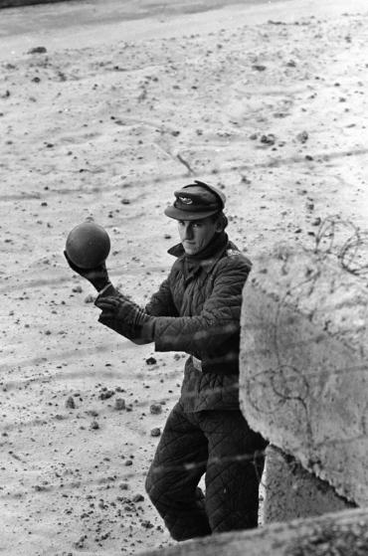
GDR Guard returns a ball

Slide 42
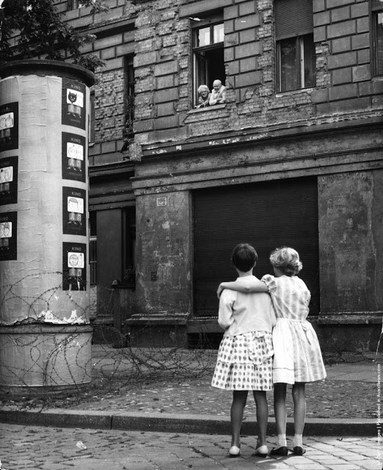
Two Girls talk to their Granparents

Slide 43
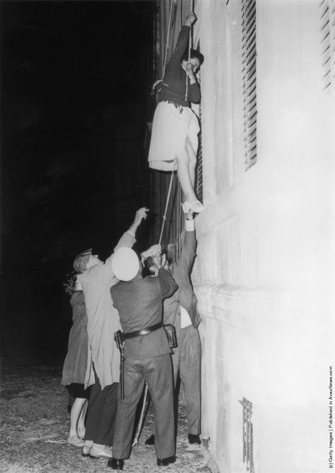
Women escape in the Early Phase

Slide 44
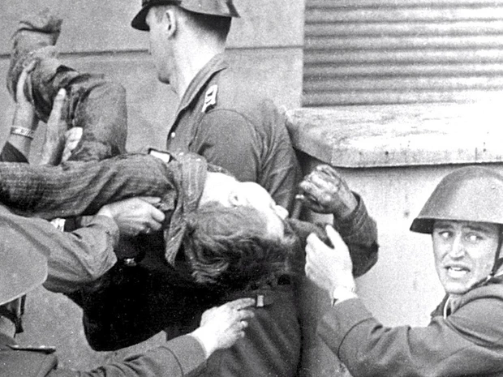
Peter Fechter – The first person to be shot crossing the Wall

Slide 45
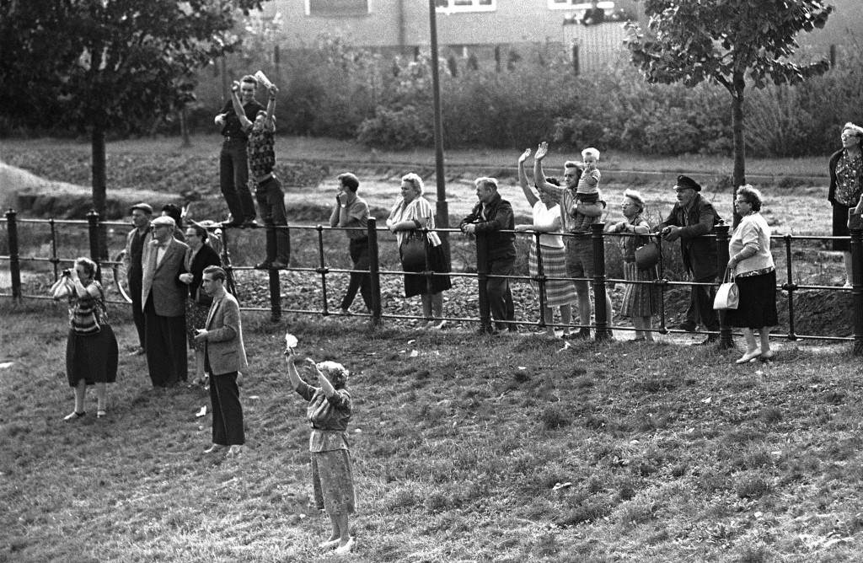
East Berliner’s wave to friends nearly a month after construction

Slide 46
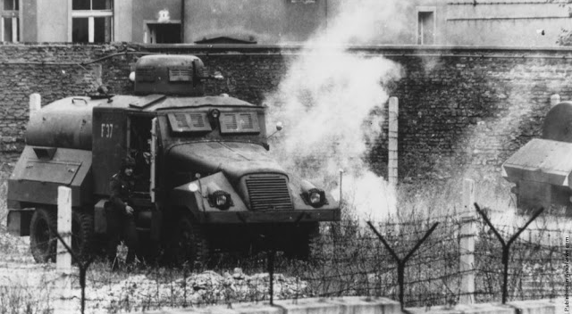
Protests on the First Anniversary

Slide 47
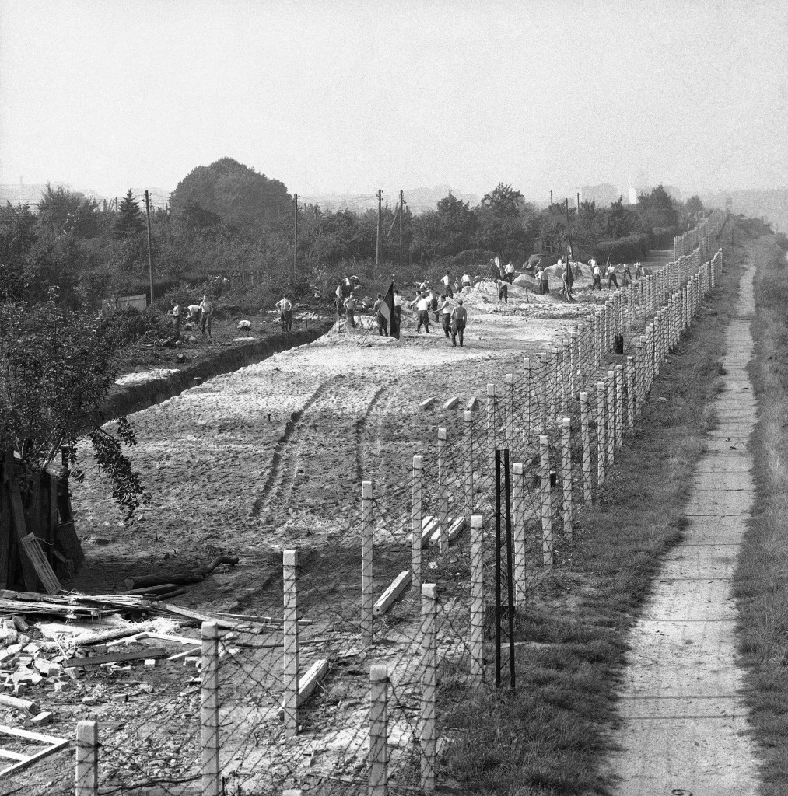
Work begins on the death strip in October 1961

Slide 48
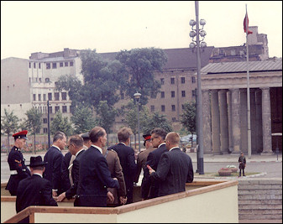
President Kennedy views the Berlin Wall

Slide 49
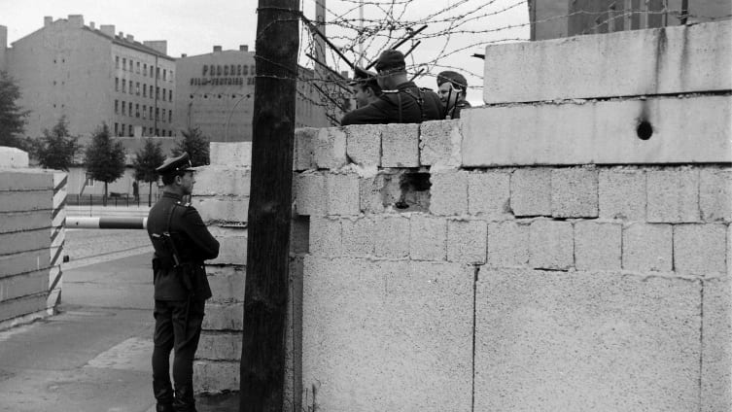
Western and Eastern Guards Chat

Slide 50
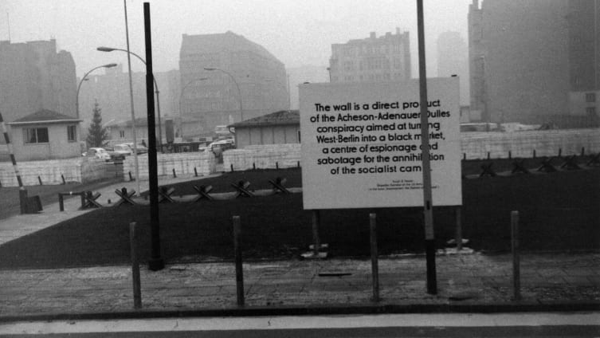
GDR Explanation of the Wall

