Slide 1
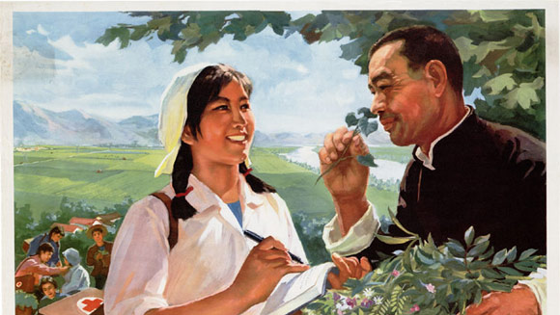
Mao and Health

Slide 2
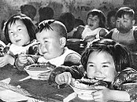
Nutrition and Living Standards
The population ate no better in 1976 than in 1949. In fact, most were worse off, with calories coming from unpopular coarse grains and sweet potatoes, rather than grain and rice. People were no longer dying of hunger as they had during the Great Famine, but their diet was exceedingly limited. Most of their calories came from grains with the addition of some vegetables. For large parts of the rural population, fruits, eggs and meat remained luxury goods, reserved for special events such as weddings and the Spring Festival.
Improvements in housing were also quite modest over the nearly three decades of Mao’s rule. Average per capita floor space in the cities declined from 4.5 to 3.6 square meters per person between 1950 and 1978.
Of course, China’s population increased from 551 million to 937 million.

Slide 3
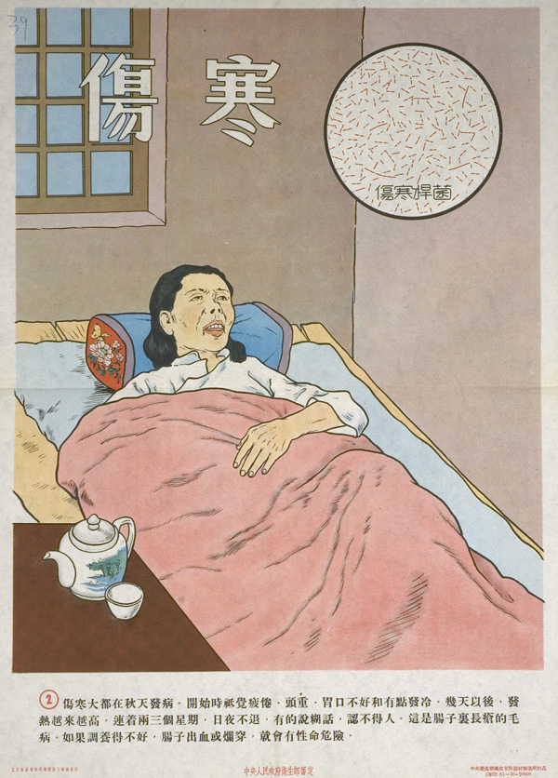
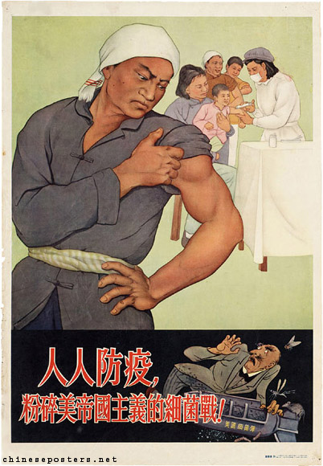
Early Health Policies
Labour and government health insurance were introduced in the early 1950s, with free health care provided to industrial workers and families, government employees, teachers, and students. However, because of financial constraints, the central government allocated only 1.2 per cent of the national budget to the healthcare sector, rapidly creating congested health services demand and limitations on state finance. Ironically, this situation widened the gap between the urban and rural areas, leaving the peasants behind (by 1964, only 16% of the health budget was spent in rural areas).
Variations in quality of care also resulted from the state’s decision to promote traditional Chinese medicine alongside Western methods. This not only played to a continued popular belief in the effectiveness of traditional remedies but also chimed with the government’s goal of reducing costs. On this point, it is interesting to note that it was the socialist state that institutionalised Chinese medicine, establishing training and research institutes for doctors and scientists to study traditional techniques.

Slide 4
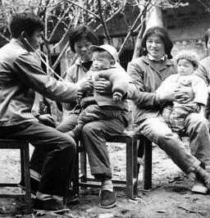
Health in Rural Areas
The government began by launching patriotic health and education campaigns to increase health awareness. The MOH identified twenty communicable diseases, but due to the financial and institutional constrains, only cholera, smallpox, and the plague were targeted as a priorities for vaccinations.
The people’s communes introduced compulsory insurance, but the contributions were minuscule, and the system became overburdened.
Midwives were trained to provide basic services in the villages, working alongside so-called “barefoot doctors” —peasants, students, or “sent-down youths” who had received crash courses in basic medical knowledge. Their brigades paid them in work points, and they lived alongside the local population. In 1965, 1.8 million were sent to rural areas, compared to 19,000 doctors previously. They have perhaps been romanticised, but they provided a bridge while county hospitals were constructed.
After the end of the famine, a system of collective rural health care, locally financed by production brigades, was gradually built up between the early 1960s and the end of the Mao era. Peasants no longer enjoyed free and unlimited access to hospitals at the county level, but their brigades would provide primary care and medication. Under this system, local cadres and barefoot doctors acted as gatekeepers, regulating access to more costly treatments in the county hospitals in cases of serious diseases. During the Cultural Revolution, specialised teams from urban hospitals were sent down to the countryside to support local doctors and clinics.
These policies helped to balance the negative views about Mao, that grew amongst the populace during the Great Leap Forward.

Slide 5
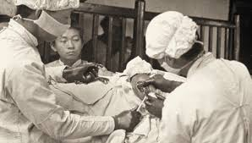
Statistics
The improvements in core health development is unmatched in the developing world.
The number of health institutions increased by 23.2 per cent.
The death rate decreased from 25.8 per thousand to 7.8 per thousand.
Life expectancy rose from 44 to 68.
Infant and childhood mortality declined by 63% and 90%, respectively.
By 1976, there were 65,000 hospitals and 20 beds per 10,000 people (Brazil is currently 24.7).
The number of doctors only increased by 5.7%. Twenty out of twenty-eight provinces actually lost doctors.

Slide 6
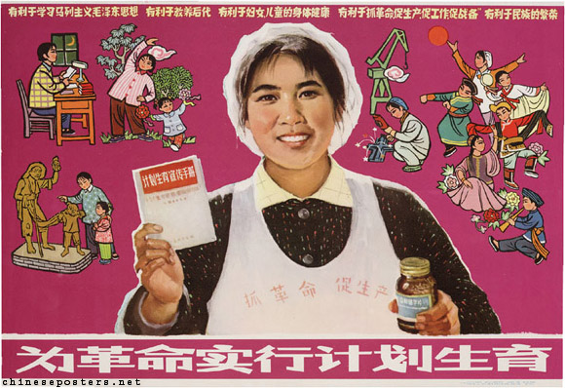
Family Planning
Historically, Marxist thinkers had typically argued against the Malthusian notion that uncontrolled population growth was a primary cause of poverty and famine.
In 1949, Mao rejected the argument that the size of China’s population would ever present a problem, and the newly founded People’s Republic introduced Soviet-style natalist policies that encouraged additional births.
In 1953, a census revealed that China’s population was 600 million, much higher than anticipated. “In response, some cadres from both the party and the Women’s Federation began to call for birth control to improve the health of women and children.
Even with the Great Famine, the population topped 700 million a decade later.
In 1964, the State Council established a new Birth Planning Commission and moved to insert targets for limiting population growth into the upcoming Third Five-Year Plan.
Free sterilisation and abortions were first trialled in urban areas, where facilities were better, and women were better educated. It was hoped that it would lower grain requirements for the peasantry. The scheme's success meant it was extended to densely populated rural areas.
Outside the cities, persuading peasants that the state needed to involve itself in their lives in such a dramatic way proved a challenge. A government that offered almost no sex education in schools found itself suddenly ordering its cadres to promote contraceptives, sterilisation and abortions. The cadres, still reeling after the Great Leap Forward, resisted pushing the policy too strongly. Some women welcomed smaller families, but others feared that without a large family, they would not be supported in their old age.
The policy was abandoned during the Cultural Revolution.
From 1971, female sterilisation, induced abortions and IUD contraceptive insertion increased rapidly. As a result, the total fertility rate (a projection of how many children the average woman would be expected to have over her lifetime based on current trends) fell from close to six around 1970 to 2.7–2.8 by the end of the decade.

Slide 7
Social Policies – Health
Topic Sentence:
1.
2.
3.
Evalaution (limtiations)

