Slide 1
“The most important effects of Early Modern wars were territorial.” Discuss with reference to two wars, each chosen from a different region.

Slide 2
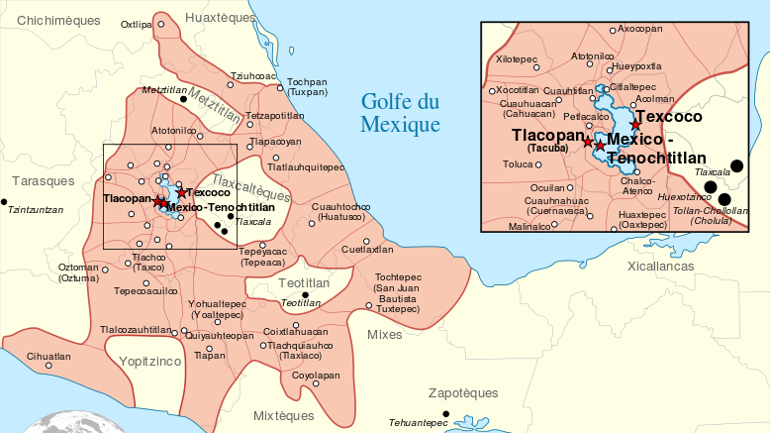

Slide 3
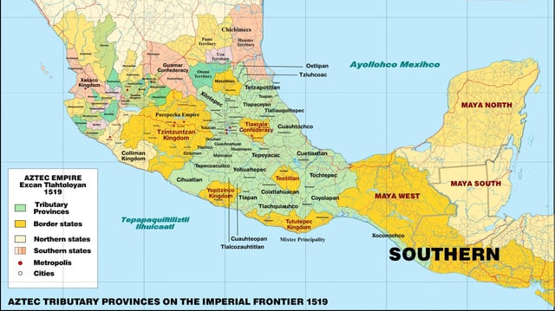

Slide 4
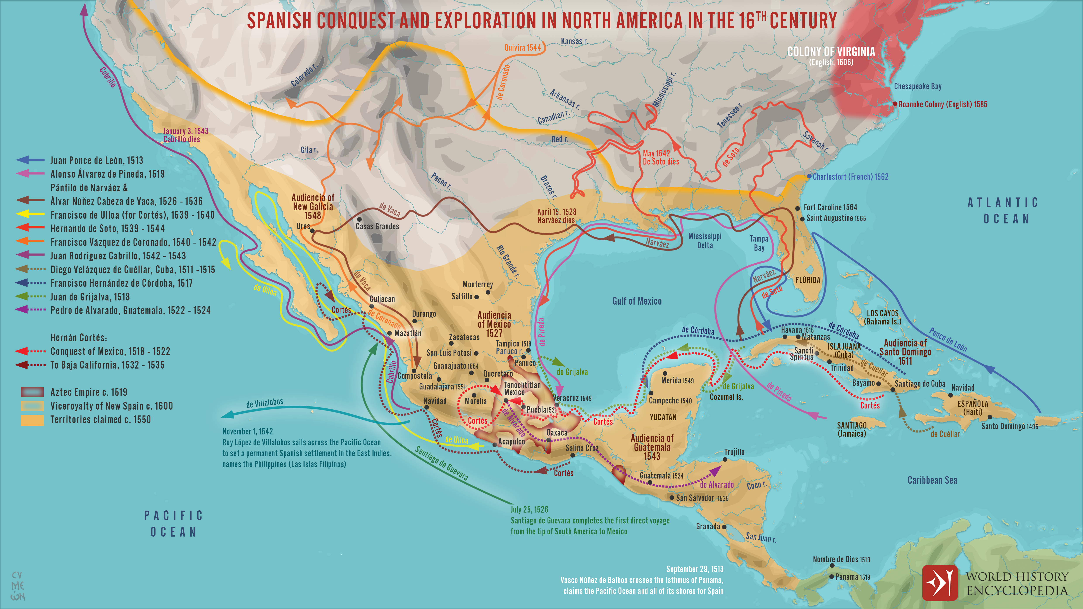

Slide 5
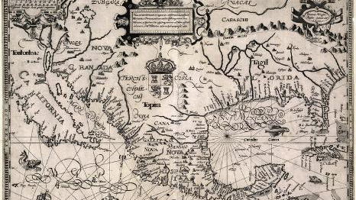
Spanish Map of their Possessions - 1600

Slide 6
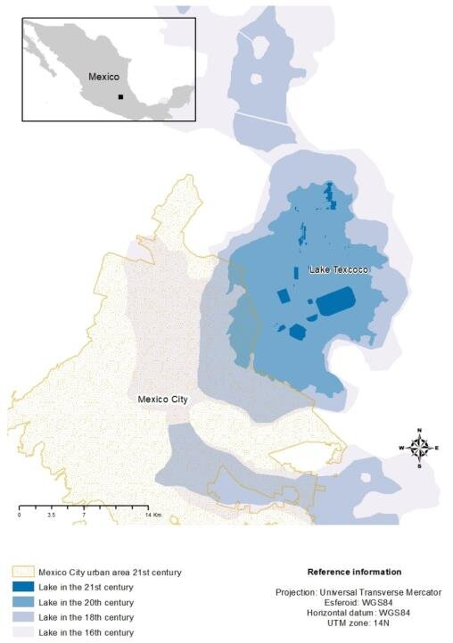

Slide 7
New Spain
Paragraph One
Paragraph Two

Slide 8
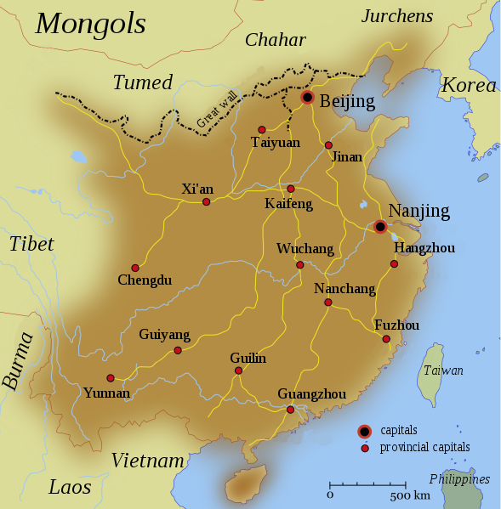

Slide 9
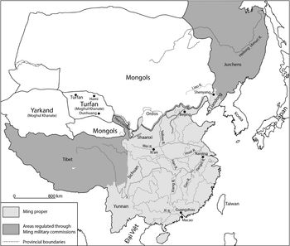

Slide 10
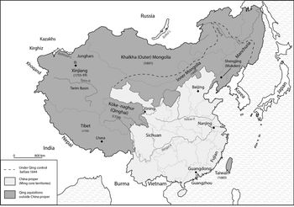

Slide 11
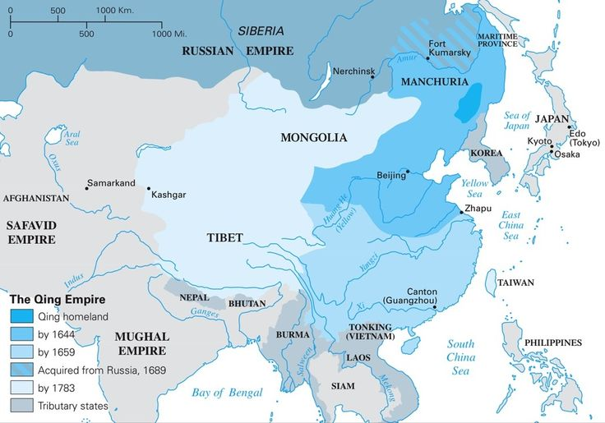

Slide 12
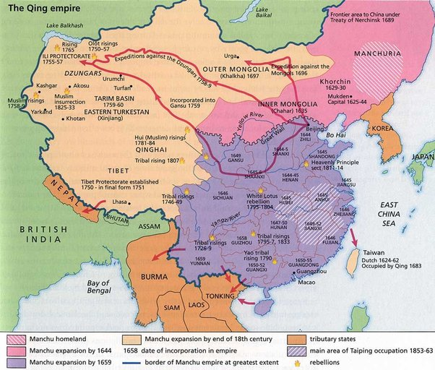

Slide 13
Qing China
Paragraph One
Paragraph Two

