Slide 1
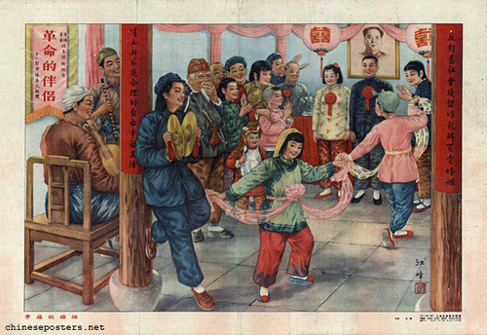
Changes under Mao: 1949-1963

Slide 2
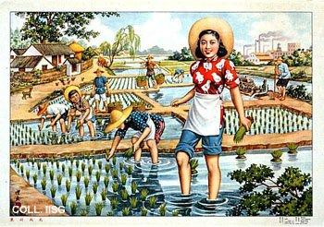
Propaganda poster: New view in the rural village, 1953

Slide 3
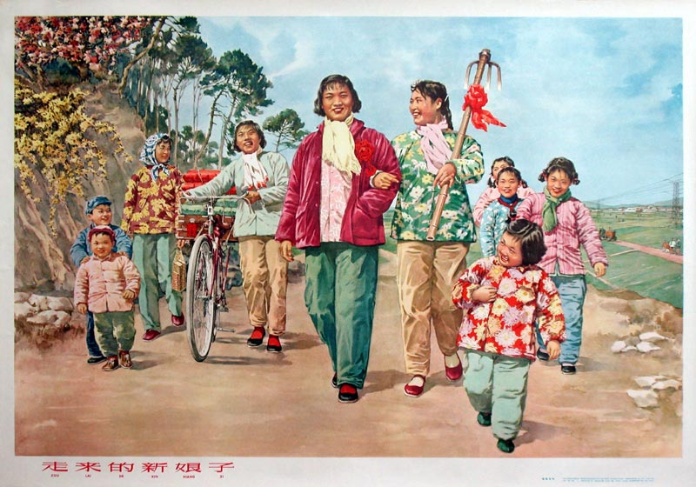

Slide 4
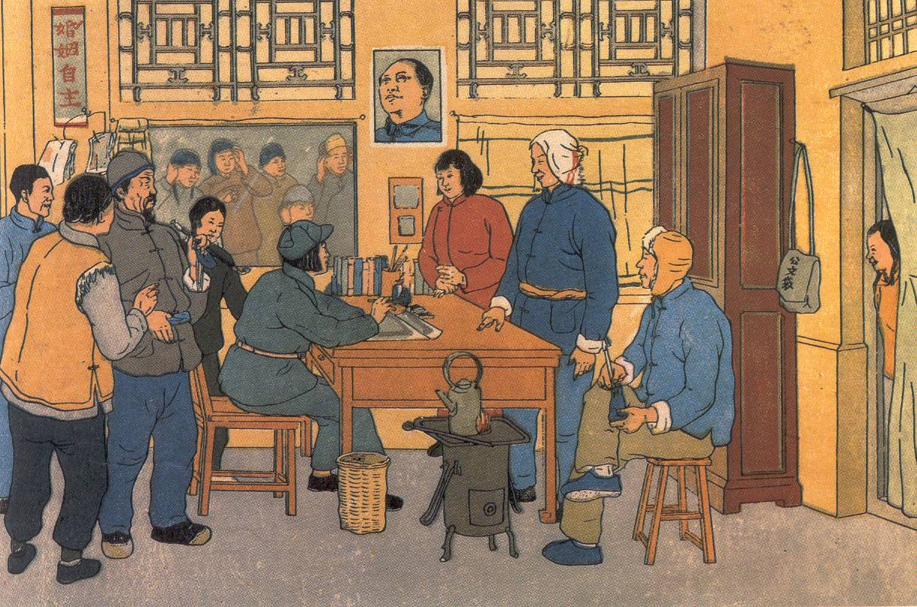
Notes:
Poster showing the registration of a marriage that has been decided on by free choice rather than having been arranged.

Slide 5
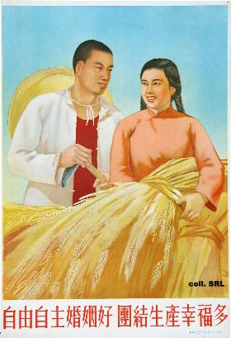
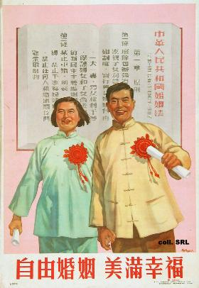
The Marriage Law was accompanied by much propaganda . . .
Notes:
The Marriage Law was accompanied by much propaganda . . .
LEFT ‘A free and independent marriage is good, there is great happiness in united production’, 1953.
RIGHT ‘Freedom of Marriage, happiness and good luck’, 1953

Slide 6
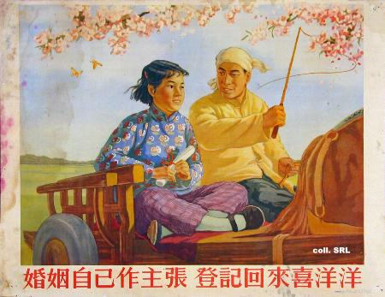
Was it all positive though?
Notes:
Who would work in the fields? The law led many to believe that its notion of 'free love', i.e. marriages that were not coerced or arranged, actually meant that people could have sex with whomever they wanted. On the other hand, the introduction of the law also led to large numbers of marriage-dispute cases, divorces, murders and suicides.

Slide 7
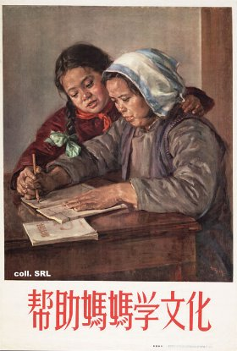
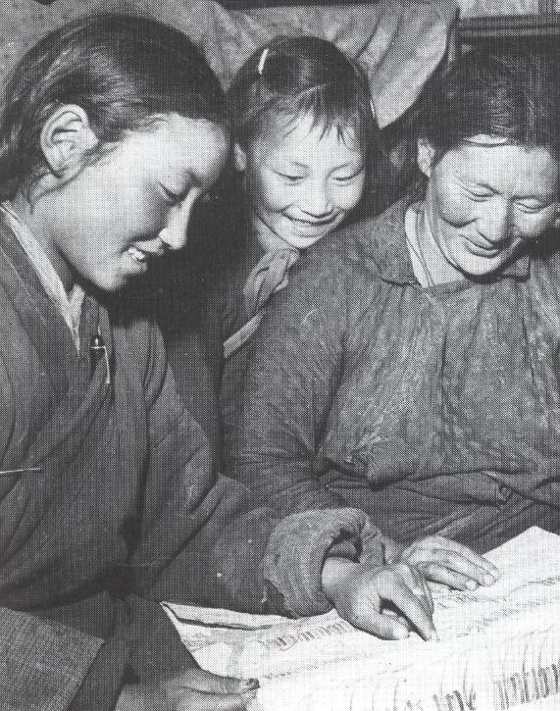
Women in Education
Notes:
LEFT ‘Helping Mama study culture campaign’, 1956
RIGHT Tibetan women being taught to read.
Between 1950 and 1960 the number of teachers in China rose from ½ million to 2½ million, and the number of primary school pupils doubled to 100 million.
Education was indoctrinated – teachers made to teach about communist beliefs

Slide 8
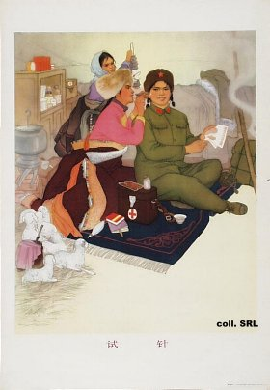
Bare foot doctors
Notes:
Women played a central role in spreading basic medical provision and ideas about hygiene to rural communities
The Communist government established a system of ‘bare foot’ doctors who were sent to peasant villages to tend to peoples basic medical needs. Women were prominent in participating in this service.
Created Creches in the work place for children to be looked after.

Slide 9
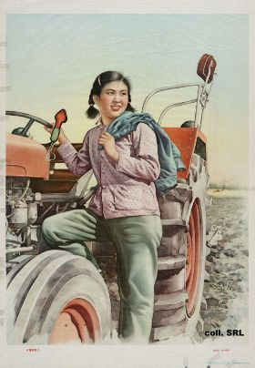
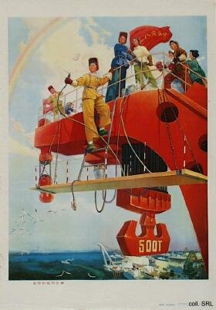
Women in Industry
Notes:
RIGHT A peasant girl about to drive a tractor.
Middle – Iron factory
LEFT ENGINEERS

Slide 10
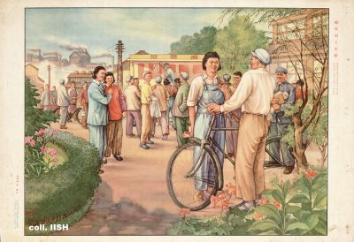
Notes:
Working in Factories

Slide 11
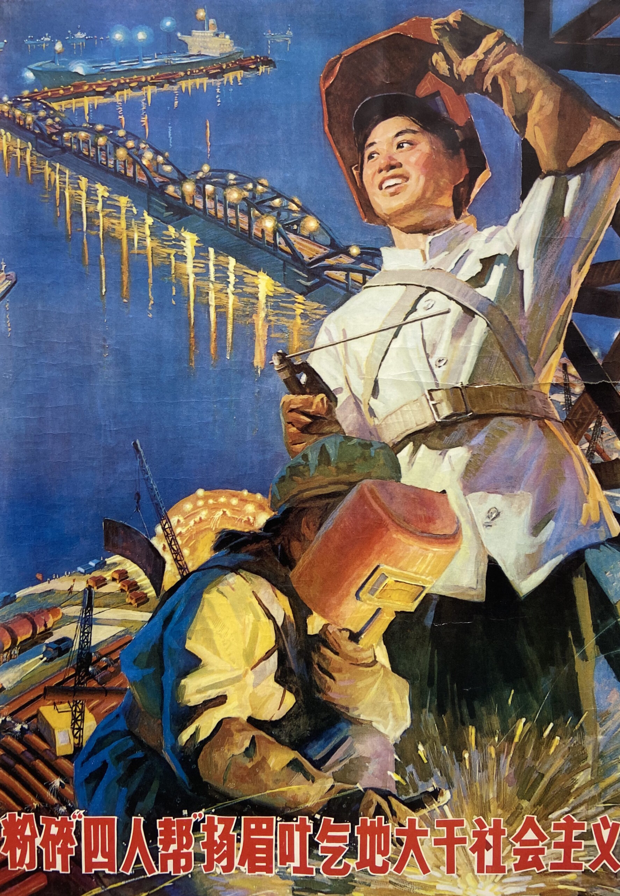
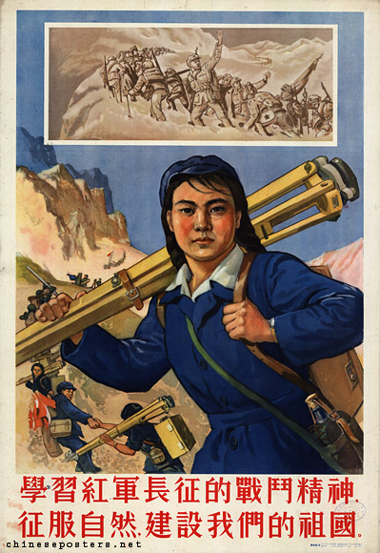

Slide 12
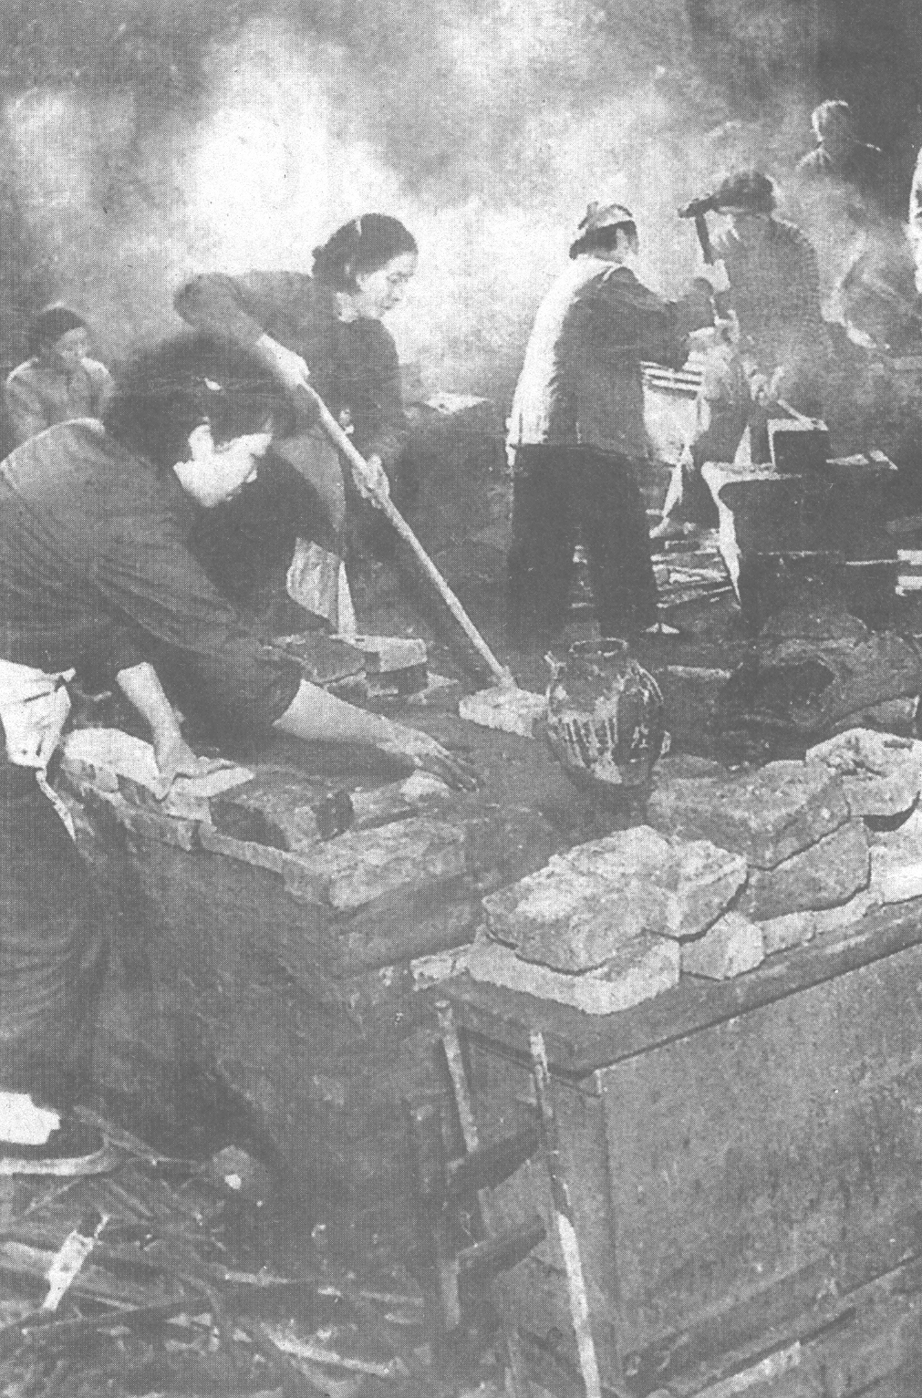
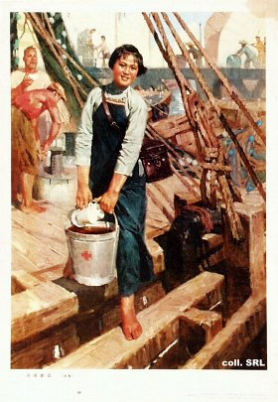
Notes:
LEFT IRON FOUNDRY
RIGHT BUILDING SITE

Slide 13
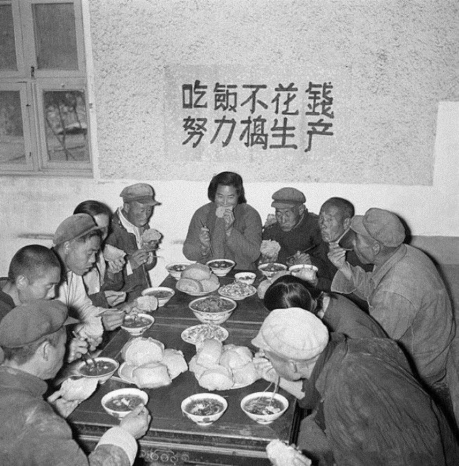

Slide 14
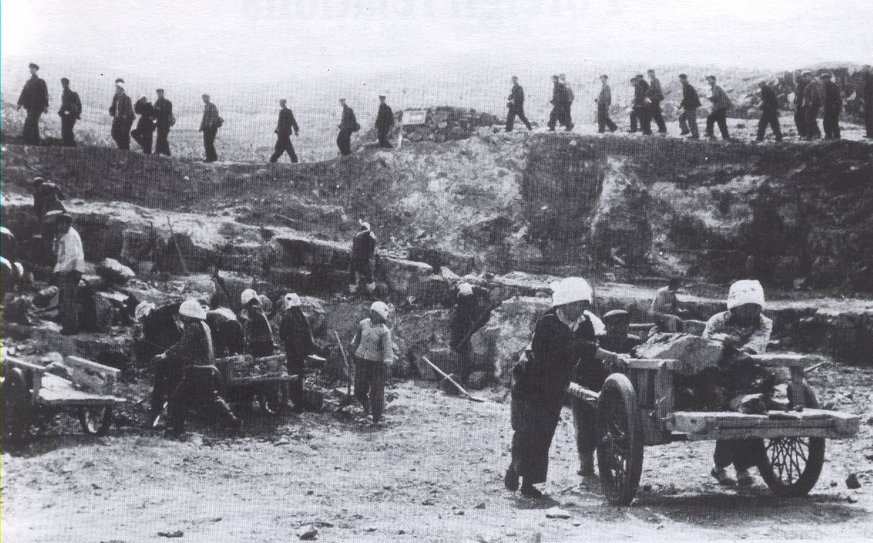
Notes:
Are women better off now?

Slide 15
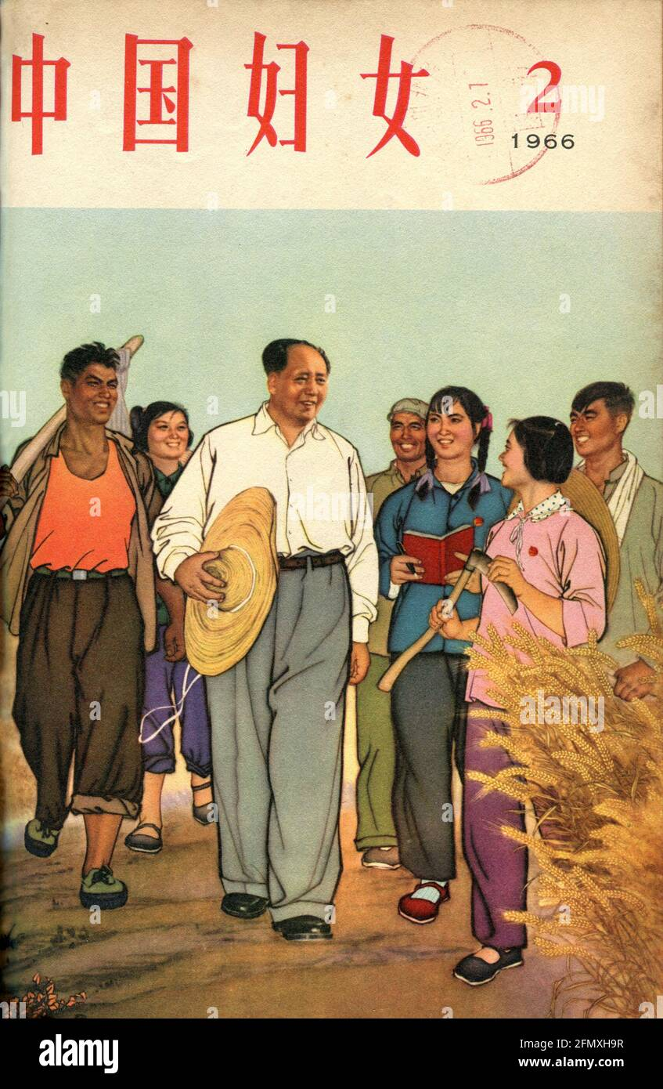
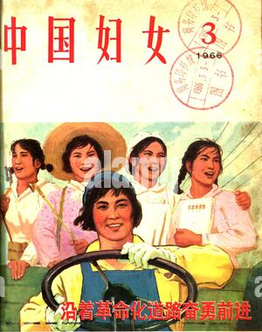
Women of New China

Slide 16
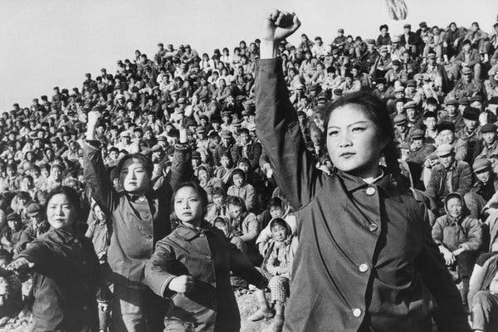
Women in the Cultural Revolution

