Slide 1
The Columbian Exchange

Slide 4
Spanish Empire

Slide 5
Plants Exchange
Old World Plants
Wheat Barley Rice
Oats Millet Sorghum
Okra Yams Lettuce
Cabbage Kohlrabi Carrots
Beans Peas Chickpas
Onions Apples Pears
Plums Citrus Apricot
Banana Sugar Coffee
Tea
New World Plants
Cotton Rubber Tobacco
Quinine Matte Cacao
Pecan Avocado Peanut
Pineapple Tomato Chili
Manioc Pumpkin Squash
Potato Corn Quinua
Beans Canihua

Slide 6
Smallpox

Slide 7
Current areas of Malaria in the Americas

Slide 8
Diptheria

Slide 9
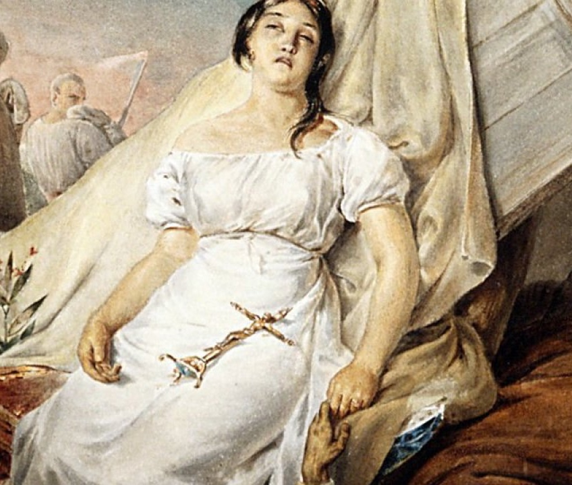
Yellow Fever

Slide 13
Did Disease have a major impact on Europe?

Slide 15
Varieties of Potato from the Andes

Slide 21
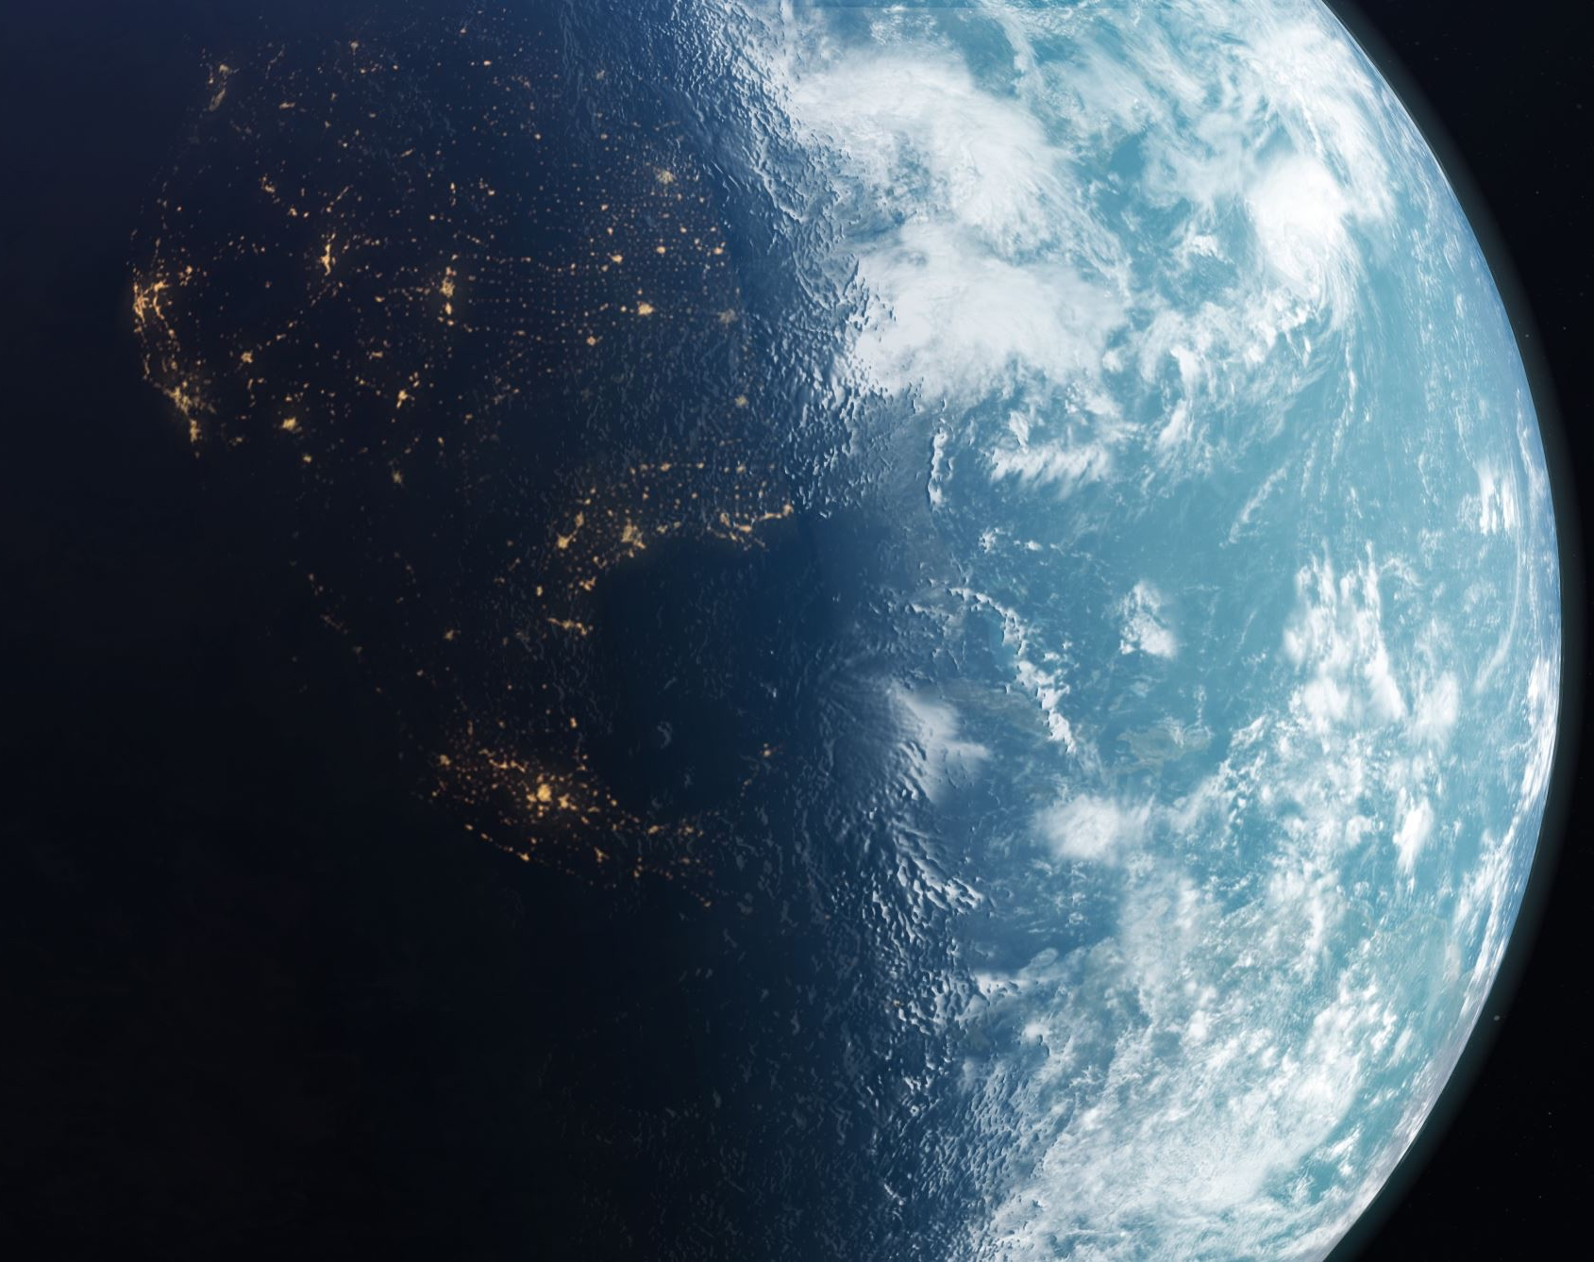
What do these tables tell us about the impact of the New World on horticulture in Europe?

Slide 22
Inflation in Europe in the 16th Century

Slide 23
Wages and Grain Prices (Potential Problems?)

Slide 25
Silver Imports to Europe

Slide 26
Mineral Production of the Spanish Americas

Slide 28
This trend does not include Spain, whose population rose only from around c7 million to c 8 million.

Slide 29
Spanish and Portuguese Trade Routes

Slide 30
How great was the economic impact of the New World on Europe?

Slide 31
Coffee and Tobacco in London around 1600

Slide 32
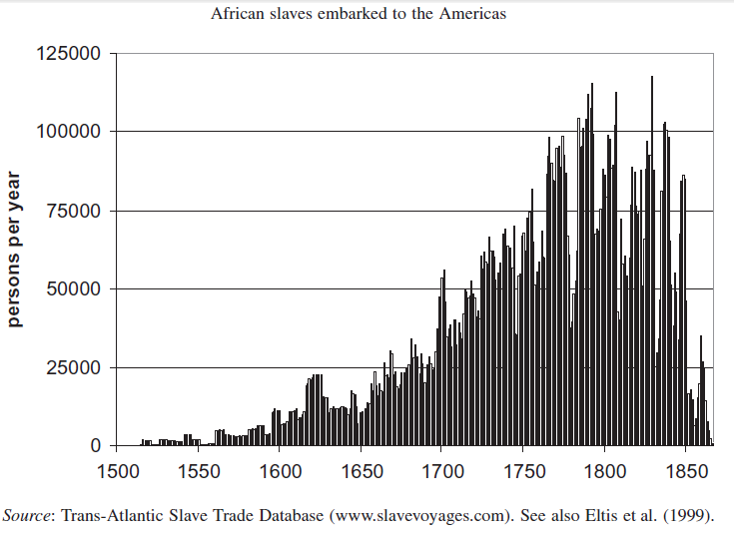

Slide 33
Spanish depiction of Taino women

Slide 34
Mustang – Horse of the Native Americans

Slide 35
Wild Pig – Descended from the Spanish Imports

Slide 37
Is it the less thought of areas which may have had the biggest impact on Europe?

