Slide 1
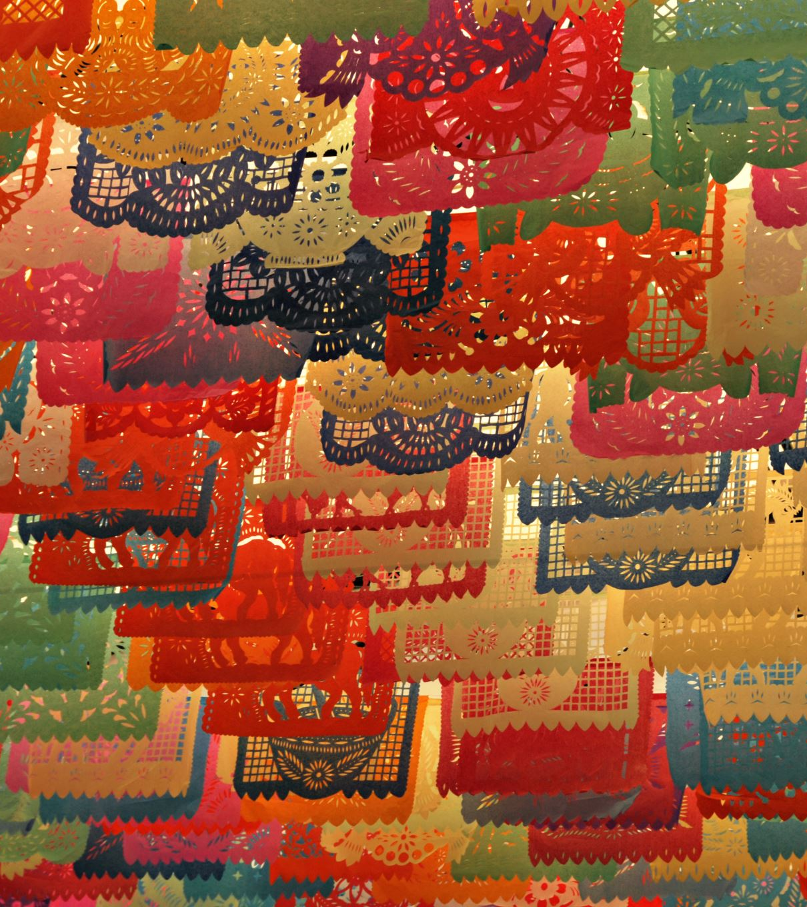
Culture under Mao
'There is no such thing as art for art's sake or art that is detached from or independent from politics'

Slide 2
Mao’s Views on Culture
As early as 1942, Mao had brushed aside the idea that art could exist simply for art’s sake. After tens of thousands of students, teachers, artists, writers and journalists had poured into Yan’an the Chairman launched a campaign to eradicate any lingering influence of free thinking among the young volunteers.
They were interrogated in front of crowds, made to confess in indoctrination meetings and forced to denounce each other in a bid to save themselves. Some were incarcerated in caves; others were put through mock executions. Mao demanded absolute loyalty from intellectuals.
Mao liked to surround himself with prominent intellectuals, but would denounce them if they disagreed with his policies.

Slide 3
Quotes
"In China 90 percent of the people have no culture or education, and of these the overwhelming majority are peasants”
“Writing novels is popular these days, isn’t it? The use of novels for anti-party activity is a great invention. Anyone wanting to overthrow a political regime must create public opinion and do some preparatory ideological work. This applies to counter-revolutionary as well as to revolutionary classes.”
"Revolutionary culture is a powerful weapon for the people. Ideologically it prepares the way for revolution. From the saying:' Without a revolutionary theory, there can be no revolutionary movement,' we can see how important the revolutionary movement is to the revolution in practice....[We] should have [our] own national, scientific and mass culture," and that it be "anti-imperialist and anti-feudal."

Slide 4
Entertainment before the Cultural Revolution
Entire libraries were burned down. The number of books published remained low in relation to the population: 20,000 titles and 900 million volumes in 1954.
Jazz was banned, and classical music decried as bourgeoise.
About 2,000 works were translated from foreign languages (mainly scientific books for educational use). Several novels were extremely successful. Defend Yunan, which was later condemned on the pretext that it had helped to glorify Peng Dehuai, sold 500,000 copies in 1954. Soviet novels were published and printed in quantity (How Steel was Tempered by Ostrovski ran to 850,000 copies). A few old popular novels were reprinted.
When the author Hu Feng, compared the stultifying literary theories of the party to knives thrust into the brains of writers – over a million individuals, theoreticians, were forced to defend themselves against accusations of treason.
The cinema made little progress; the number of films released each year (dubbed or made in China) increased from 43 to 119 between 1952 and 1957,16 while the number of projection teams rose from 1,110 to 6,692. Only Soviet films were allowed from abroad. Film distribution posed various technical and material problems, and the cinema has for a long time been superseded by the theater, which continued to develop (2,017 troupes in 1952, 2,808 in 1957), and retained pride of place. Travelling troupes bought revolutionary ideas to the villages.
However, the GLF loosened party control. Feudal operas returned in the countryside, government departments and universities imported foreign journals and magazines, and peddlers in cities sold illegal books around the wharves and train stations.

Slide 5
Art before the Cultural Revolution
The Communist Party took total control of art education and the lives and works of the artists themselves, and the Central Academy of Beijing became the model for regulated art schools throughout the country.
Artists were called on to paint subjects (such as images of Mao, the rural peasantry, or scenes of technological progress) using the Soviet social realism.
Oil replaced ink painting—which had previously been one of the most revered art forms in China—as the preferred style.
Even more important for the future of Chinese art was the fact that peasants and workers were initially encouraged to take up the brush and depict their own worlds. Interest shifted toward art picturing the lives of the rural masses: the soldiers, peasants, and workers—with special attention to women and others who had been excluded or sidelined in Chinese society previously. This constituted a radical break from a long established tradition in China where art was associated with the social and political elite.

Slide 6
Cheng Miingsheng, “Women Hold Up Half of the Sky,”1953

Slide 7
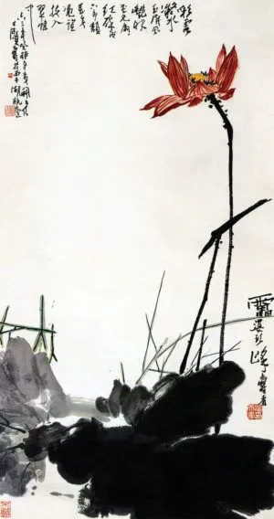
Pan Tianshou, Red Lotus, 1963

Slide 8
Rent Collection Courtyard

Slide 9
Unknown Papercuts of Revolutionary Heroes

Slide 10
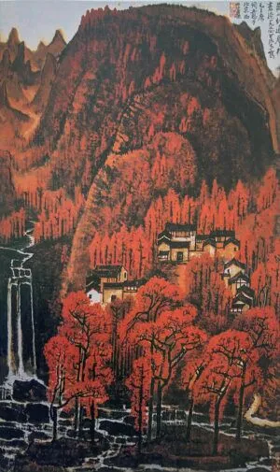
Li Keran, Ten Thousand Crimson Hills, 1964
How could this work be offering a commentary on the last years under the CCP?

Slide 11
Jin Zhilin, Brigade Secretary of the Yugeng People’s Commune, Huailai County, Hebei Province, 1960

Slide 12
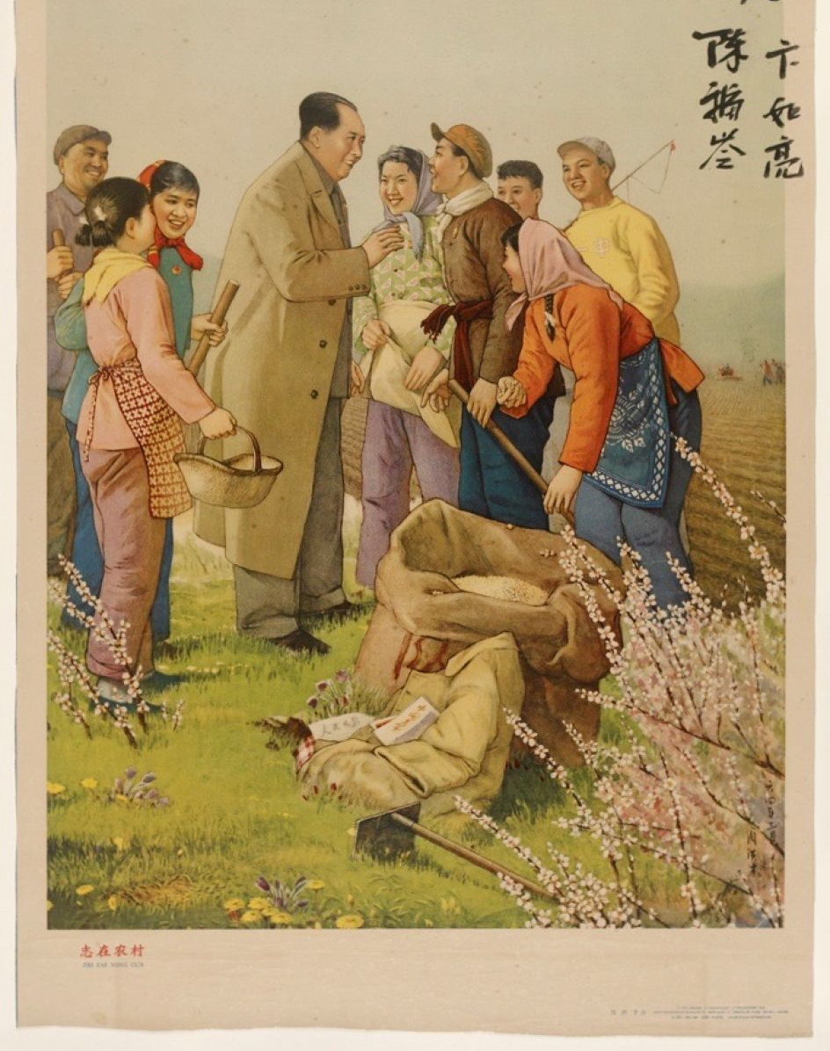
Hongcai Zhou, Chairman Mao talking to farmers in a spring landscape, 1964

Slide 13
Sun Zixi, In Front of Tiananmen, 1964.

Slide 14
Paragraphs
Views + Art
Other Entertainment

Slide 15
Ethos of the Cultural Revolution
Mao had begun taking aim at the Ministry of Culture in 1963 for failing to curb the spread of feudal, superstitious and revisionist ideas. He suggested that it should change its name to the ‘Ministry of Gifted Scholars and Beautiful Ladies or ‘Ministry of Foreign Dead People’. He also accused the All-China Federation of Literature and Art of tottering on the edge of revisionism: ‘For the last fifteen years, they have not been carrying out the party’s policy.’
The Cultural Revolution devolved into a period of widespread chaos. Few artworks survived the decade, though artists strove to advance Communist interests through revolutionary topics and propaganda. Mao’s last wife, a former Shanghai movie actress named Jiang Qing, became a leading authority in the arts and a key figure politically. Her zealousness is often attributed to an attempt to mask her lifestyle as an actress in Shanghai in the 1930s or her controversial marriage to Mao in 1942. Her sudden promotion may have also been to placate her after the Chairman began an affair with the 18-year-old stewardess, Zhang Yufeng.
The Cultural Revolution began when Jiang settled scores with Tian Han, an old enemy from Shanghai, who offended Mao with a play centred on an aging master and his young concubine.

Slide 16
Art in the Cultural Revolution
Well-respected older artists, whose ink paintings had been revered, found their work not only out of fashion but scorned as examples of bourgeois decadence. These older artists sometimes modified their works to accommodate revolutionary themes. Many artists, however, saw their works destroyed, and were persecuted and imprisoned, while others found their works denigrated in "black painting" exhibitions. Suicide was common.
At the same time, younger artists reveled in new found opportunities and aspired to have their paintings become "model works" that would be reproduced hundreds of millions of times in posters and newspapers.
Artists were forced to adopt a style called “revolutionary romanticism.”
Before the Cultural Revolution the range of subjects may have been narrow but the quality was high, and could emulated more widely than previously. Little of value was created during between 1966 and 1972.

Slide 17
Other Entertainment during the Cultural Revolution
The Socialist Education Movement limited the activities of those circles interested in literature, art, and the social sciences; the Cultural Revolution eliminated these people professionally and sometimes physically. The first to be hit were novelists, playwrights, and poets, with many prominent writers murdered.
Eight socialist dramas, operas, or ballets, brought out before 1966, were revised, and a little music was written after Madam Mao found links between the piano and revolution.
Jiang Qing's rejection of all non-proletarian culture was political correctness in its most extreme form. This was an intellectually and emotionally destructive process that aimed ta the systematic undermining of all sense of tradition. In accordance with Mao's saying, 'the more brutal, the more revolutionary', children were urged to knock the heads off flowers in order to show their rejection of bourgeois concepts of beauty. Zhou Guanrun, a professor of music, recalled how Jiang's edicts against bourgeois culture terrorised hte staff at the Beijing Conservatoire into silence.
No music sounded any more. The conservatoire was silent. Everybody was just learning and doing self-criticism or accepting criticism from students. So we had to come every day, every morning at the time of office hours and sit there and read books and then do criticism. We had to analyse our mistakes in our work, our teaching or performing, because we performed a lot of classical or Chinese traditional music. We thought that we popularised the bad things to the young generation.
For some it was worse. Musicians who were sent to work ni the fields; pianists and string players were made to scratch at the ground with their hands so that they would lose the vital sensitivity in their fingers and never be able to play well again.

Slide 18
Liu Chunhua, Chairman Mao en Route to Anyuan, 1967

Slide 19
Chen Yanning, Chairman Mao Inspects the Guangdong Countryside, 1972.

Slide 20
Yuang Zhixian, “An Exhibition to Criticize Lin Biao and Confucius,” 1973

Slide 21
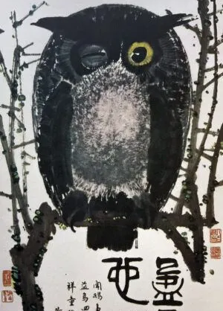
Huang Yongyu, Winking Owl, 1973
This work headlined the Black Painting Exhibition in Beijing in 1974. Why was it considered subversive.

Slide 22
Song Wenzhi, New Aspects of Lake Tai, 1973

Slide 23
Paragraphs
Ethos + Art
Other Entertainment

Slide 24
Consequences
The Cultural Revolution set China back decades.
An entire culture was almost wiped out, to be replaced by nothing.
Generational instruction that occurred for centuries ceased.
Recriminations existed between those who suffered and those who failed to speak out.
The reputation of the party never really recovered.

